Slide 1
스프링 답변형 게시판

Slide 2
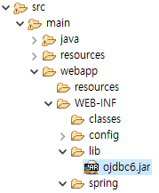
스프링 답변형 게시판
1. 프로젝트 pro30 (spring legacy mvc로 만들고 환경설정하기)
- pom.xml의 설정(타일즈와 마이바티스 관련 라이브러리를 추가하기
- 오라클db 드라이버 설치 (오픈소스가 아니라서 별도 설치 필요)
<!-- 마이바티스 -->
<dependency>
<groupId>commons-beanutils</groupId>
<artifactId>commons-beanutils</artifactId>
<version>1.8.0</version>
</dependency>
<dependency>
<groupId>commons-dbcp</groupId>
<artifactId>commons-dbcp</artifactId>
<version>1.2.2</version>
</dependency>
<dependency>
<groupId>cglib</groupId>
<artifactId>cglib-nodep</artifactId>
<version>2.2</version>
</dependency>
<dependency>
<groupId>org.mybatis</groupId>
<artifactId>mybatis</artifactId>
<version>3.1.0</version>
</dependency>
<dependency>
<groupId>org.mybatis</groupId>
<artifactId>mybatis-spring</artifactId>
<version>1.1.0</version>
</dependency>
<!-- 타일즈 관련 라이브러리 -->
<dependency>
<groupId>org.apache.tiles</groupId>
<artifactId>tiles-core</artifactId>
<version>2.2.2</version>
</dependency>
<dependency>
<groupId>org.apache.tiles</groupId>
<artifactId>tiles-jsp</artifactId>
<version>2.2.2</version>
</dependency>
<dependency>
<groupId>org.apache.tiles</groupId>
<artifactId>tiles-servlet</artifactId>
<version>2.2.2</version>
</dependency>

Slide 3
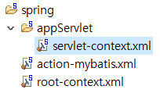
스프링 답변형 게시판
2. servlet-context.xml설정하기.
- 타일즈 사용에 따른 기존 ViewResolver 주석처리하고, pom.xml에 설정한 라이브러리 관련 빈 설정하기
<?xml version="1.0" encoding="UTF-8"?>
<beans:beans
xmlns="http://www.springframework.org/schema/mvc"
xmlns:xsi="http://www.w3.org/2001/XMLSchema-instance"
xmlns:beans="http://www.springframework.org/schema/beans"
xmlns:mvc="http://www.springframework.org/schema/mvc"
xmlns:context="http://www.springframework.org/schema/context"
xsi:schemaLocation="http://www.springframework.org/schema/mvc http://www.springframework.org/schema/mvc/spring-mvc.xsd
http://www.springframework.org/schema/beans http://www.springframework.org/schema/beans/spring-beans.xsd
http://www.springframework.org/schema/context http://www.springframework.org/schema/context/spring-context.xsd">
<!-- DispatcherServlet Context: defines this servlet's request-processing
infrastructure -->
<!-- Enables the Spring MVC @Controller programming model -->
<annotation-driven />
<!-- Handles HTTP GET requests for /resources/** by efficiently serving
up static resources in the ${webappRoot}/resources directory -->
<resources mapping="/resources/**" location="/resources/" />
<!-- Resolves views selected for rendering by @Controllers to .jsp resources
in the /WEB-INF/views directory -->
<!--
<beans:bean class="org.springframework.web.servlet.view.InternalResourceViewResolver">
<beans:property name="prefix" value="/WEB-INF/views/" />
<beans:property name="suffix" value=".jsp" />
</beans:bean>
-->

Slide 4
스프링 답변형 게시판
<beans:bean id="tilesConfigurer" class="org.springframework.web.servlet.view.tiles2.TilesConfigurer">
<beans:property name="definitions">
<beans:list>
<beans:value>classpath:tiles/*.xml</beans:value>
</beans:list>
</beans:property>
<beans:property name="preparerFactoryClass"
value="org.springframework.web.servlet.view.tiles2.SpringBeanPreparerFactory" />
</beans:bean>
<beans:bean id="viewResolver"
class="org.springframework.web.servlet.view.UrlBasedViewResolver">
<beans:property name="viewClass" value="org.springframework.web.servlet.view.tiles2.TilesView" />
</beans:bean>
<context:component-scan base-package="com.myspring.pro30" />
<!-- ViewName 인터셉트 -->
<mvc:interceptors>
<mvc:interceptor>
<mvc:mapping path="/*/*.do"/>
<beans:bean class="com.myspring.pro30.common.interceptor.ViewNameInterceptor" />
</mvc:interceptor>
</mvc:interceptors>
</beans:beans>
30.1 기존 소스 코드 변경하기

Slide 5
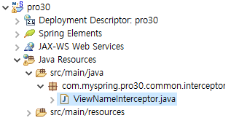
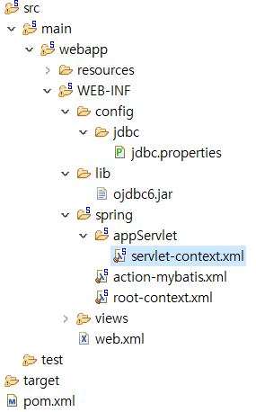
스프링 답변형 게시판
3. ViewNameInterceptor 추가하기.
- com/myspring/pro30 패키지 하위에 다시 common/interceptor 패키지를 만든 후 인터셉터 파일을
생성하기
xmlns:mvc="http://www.springframework.org/schema/mvc"
: :
<mvc:interceptors>
<mvc:interceptor>
<mvc:mapping path="/*/*.do"/>
<beans:bean class="com.myspring.pro30.common.interceptor.ViewNameInterceptor" />
</mvc:interceptor>
</mvc:interceptors>

Slide 6
스프링 답변형 게시판
package com.myspring.pro30.common.interceptor;
import javax.servlet.http.HttpServletRequest;
import javax.servlet.http.HttpServletResponse;
import org.springframework.web.servlet.ModelAndView;
import org.springframework.web.servlet.handler.HandlerInterceptorAdapter;
public class ViewNameInterceptor extends HandlerInterceptorAdapter {
@Override
public boolean preHandle(HttpServletRequest request, HttpServletResponse response, Object handler) {
try {
String viewName = getViewName(request);
request.setAttribute("viewName", viewName);
} catch (Exception e) {
e.printStackTrace();
}
return true;
}
@Override
public void postHandle(HttpServletRequest request, HttpServletResponse response, Object handler,
ModelAndView modelAndView) throws Exception {
}
@Override
public void afterCompletion(HttpServletRequest request, HttpServletResponse response, Object handler, Exception ex)
throws Exception {
}

Slide 7
스프링 답변형 게시판
private String getViewName(HttpServletRequest request) throws Exception {
String contextPath = request.getContextPath();
String uri = (String) request.getAttribute("javax.servlet.include.request_uri");
if (uri == null || uri.trim().equals("")) {
uri = request.getRequestURI();
}
int begin = 0;
if (!((contextPath == null) || ("".equals(contextPath)))) {
begin = contextPath.length();
}
int end;
if (uri.indexOf(";") != -1) {
end = uri.indexOf(";");
} else if (uri.indexOf("?") != -1) {
end = uri.indexOf("?");
} else {
end = uri.length();
}
String fileName = uri.substring(begin, end);
if (fileName.indexOf(".") != -1) {
fileName = fileName.substring(0, fileName.lastIndexOf("."));
}
if (fileName.lastIndexOf("/") != -1) {
fileName = fileName.substring(fileName.lastIndexOf("/", 1), fileName.length());
}
return fileName;
}
}

Slide 8
스프링 답변형 게시판
4. XML 설정하기(마이바티스 설정)
- web.xml과 action-mybatis.xml
web.xml
<?xml version="1.0" encoding="UTF-8"?>
<web-app version="2.5" xmlns="http://java.sun.com/xml/ns/javaee"
xmlns:xsi="http://www.w3.org/2001/XMLSchema-instance"
xsi:schemaLocation="http://java.sun.com/xml/ns/javaee http://java.sun.com/xml/ns/javaee/web-app_2_5.xsd">
<filter>
<filter-name>encodingFilter</filter-name>
<filter-class>
org.springframework.web.filter.CharacterEncodingFilter
</filter-class>
<init-param>
<param-name>encoding</param-name>
<param-value>UTF-8</param-value>
</init-param>
</filter>
<filter-mapping>
<filter-name>encodingFilter</filter-name>
<url-pattern>/*</url-pattern>
</filter-mapping>
<!-- The definition of the Root Spring Container shared by all Servlets and Filters -->
<context-param>
<param-name>contextConfigLocation</param-name>
<param-value>/WEB-INF/spring/action-mybatis.xml</param-value>
</context-param>
<!-- Creates the Spring Container shared by all Servlets and Filters -->
<listener>
<listener-class>org.springframework.web.context.ContextLoaderListener</listener-class>
</listener>

Slide 9
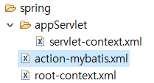
스프링 답변형 게시판
action-mybatis.xml
<?xml version="1.0" encoding="UTF-8"?>
<beans
xsi:schemaLocation="http://www.springframework.org/schema/beans http://www.springframework.org/schema/beans/spring-beans.xsd http://www.springframework.org/schema/context http://www.springframework.org/schema/context/spring-context.xsd http://www.springframework.org/schema/tx http://www.springframework.org/schema/tx/spring-tx-3.0.xsd"
xmlns:tx="http://www.springframework.org/schema/tx" xmlns:context="http://www.springframework.org/schema/context"
xmlns:xsi="http://www.w3.org/2001/XMLSchema-instance" xmlns="http://www.springframework.org/schema/beans">
<bean id="propertyPlaceholderConfigurer"
class="org.springframework.beans.factory.config.PropertyPlaceholderConfigurer">
<property name="locations">
<value>/WEB-INF/config/jdbc/jdbc.properties</value>
</property>
</bean>
<bean id="dataSource" class="org.apache.ibatis.datasource.pooled.PooledDataSource">
<property name="driver" value="${jdbc.driverClassName}" />
<property name="url" value="${jdbc.url}" />
<property name="username" value="${jdbc.username}" />
<property name="password" value="${jdbc.password}" />
</bean>
<bean id="sqlSessionFactory"
class="org.mybatis.spring.SqlSessionFactoryBean">
<property name="dataSource" ref="dataSource" />
<property name="configLocation"
value="classpath:mybatis/model/modelConfig.xml" />
<property name="mapperLocations" value="classpath:mybatis/mappers/*.xml" />
</bean>
<bean id="sqlSession"
class="org.mybatis.spring.SqlSessionTemplate">
<constructor-arg index="0" ref="sqlSessionFactory"></constructor-arg>
</bean>
</beans>

Slide 10
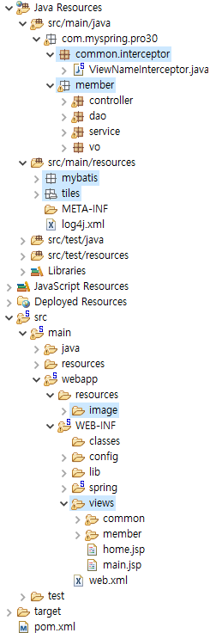
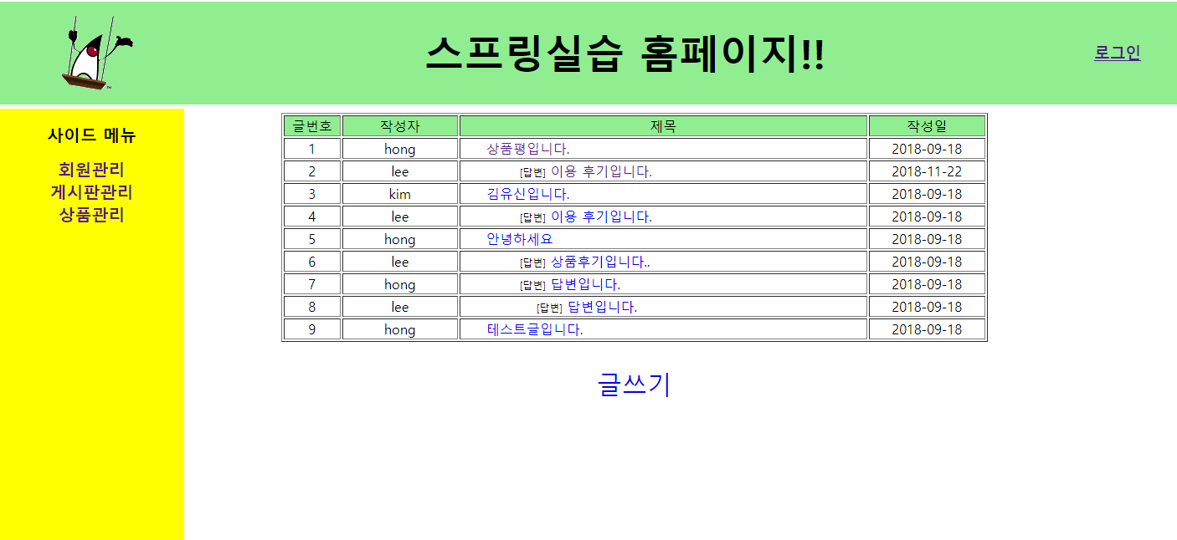
스프링 답변형 게시판
5. pro30 전체 directory 구조
- 기존 pro27. 회원관리(member)와 연계하여 타일즈로 게시판을 설정함

Slide 11
스프링 답변형 게시판
6. 회원 기능 중 게시판 실습에 필요한 자바 코드와 JSP 파일을 수정
컨트롤러에 /main.do로 요청하면 main.jsp를 표시해 주는 main() 메서드를 추가
package com.myspring.pro30.member.controller;
import java.util.List;
import javax.servlet.http.HttpServletRequest;
import javax.servlet.http.HttpServletResponse;
import javax.servlet.http.HttpSession;
import org.springframework.beans.factory.annotation.Autowired;
import org.springframework.context.annotation.EnableAspectJAutoProxy;
import org.springframework.stereotype.Controller;
import org.springframework.web.bind.annotation.ModelAttribute;
import org.springframework.web.bind.annotation.RequestMapping;
import org.springframework.web.bind.annotation.RequestMethod;
import org.springframework.web.bind.annotation.RequestParam;
import org.springframework.web.servlet.ModelAndView;
import org.springframework.web.servlet.mvc.support.RedirectAttributes;
import com.myspring.pro30.member.service.MemberService;
import com.myspring.pro30.member.vo.MemberVO;
@Controller("memberController")
//@EnableAspectJAutoProxy
public class MemberControllerImpl implements MemberController {
@Autowired
private MemberService memberService;
@Autowired
MemberVO memberVO ;

Slide 12
스프링 답변형 게시판
@RequestMapping(value = { "/","/main.do"}, method = RequestMethod.GET)
private ModelAndView main(HttpServletRequest request, HttpServletResponse response) {
String viewName = (String)request.getAttribute("viewName");
ModelAndView mav = new ModelAndView();
mav.setViewName(viewName);
return mav;
}
@Override
@RequestMapping(value="/member/listMembers.do" ,method = RequestMethod.GET)
public ModelAndView listMembers(HttpServletRequest request, HttpServletResponse response) throws Exception {
// request.setCharacterEncoding("utf-8");
response.setContentType("html/text;charset=utf-8");
String viewName = (String)request.getAttribute("viewName");
List membersList = memberService.listMembers();
ModelAndView mav = new ModelAndView(viewName);
mav.addObject("membersList", membersList);
return mav;
}
@Override
@RequestMapping(value="/member/addMember.do" ,method = RequestMethod.POST)
public ModelAndView addMember(@ModelAttribute("member") MemberVO member,
HttpServletRequest request, HttpServletResponse response) throws Exception {
// request.setCharacterEncoding("utf-8");
response.setContentType("html/text;charset=utf-8");
int result = 0;
result = memberService.addMember(member);
ModelAndView mav = new ModelAndView("redirect:/member/listMembers.do");
return mav;
}

Slide 13
스프링 답변형 게시판
@Override
@RequestMapping(value="/member/removeMember.do" ,method = RequestMethod.GET)
public ModelAndView removeMember(@RequestParam("id") String id,
HttpServletRequest request, HttpServletResponse response) throws Exception{
request.setCharacterEncoding("utf-8");
memberService.removeMember(id);
ModelAndView mav = new ModelAndView("redirect:/member/listMembers.do");
return mav;
}
@Override
@RequestMapping(value = "/member/login.do", method = RequestMethod.POST)
public ModelAndView login(@ModelAttribute("member") MemberVO member,
RedirectAttributes rAttr,
HttpServletRequest request, HttpServletResponse response) throws Exception {
ModelAndView mav = new ModelAndView();
memberVO = memberService.login(member);
if(memberVO != null) {
HttpSession session = request.getSession();
session.setAttribute("member", memberVO);
session.setAttribute("isLogOn", true);
//mav.setViewName("redirect:/member/listMembers.do");
String action = (String)session.getAttribute("action");
session.removeAttribute("action");
if(action!= null) {
mav.setViewName("redirect:"+action);
}else {
mav.setViewName("redirect:/member/listMembers.do");
}
}else {
rAttr.addAttribute("result","loginFailed");
mav.setViewName("redirect:/member/loginForm.do");
}
return mav;
}
로그인 실패 시 메시지를 전달하기 위한 클래스를 활용하여 redirect하면 request가 변경되어 바인딩한 데이터 유실을 막기 위해서 사용
27장 코드에 추가한 내용으로써,
추후 23. 번호에서 추가할 내용임
result: 로그인 성공여부

Slide 14
스프링 답변형 게시판
@Override
@RequestMapping(value = "/member/logout.do", method = RequestMethod.GET)
public ModelAndView logout(HttpServletRequest request, HttpServletResponse response) throws Exception {
HttpSession session = request.getSession();
session.removeAttribute("member");
session.removeAttribute("isLogOn");
ModelAndView mav = new ModelAndView();
mav.setViewName("redirect:/member/listMembers.do");
return mav;
}
@RequestMapping(value = "/member/*Form.do", method = RequestMethod.GET)
private ModelAndView form(@RequestParam(value= "result", required=false) String result,
@RequestParam(value= "action", required=false) String action,
HttpServletRequest request,
HttpServletResponse response) throws Exception {
String viewName = (String)request.getAttribute("viewName");
HttpSession session = request.getSession();
session.setAttribute("action", action);
ModelAndView mav = new ModelAndView();
mav.addObject("result",result);
mav.setViewName(viewName);
return mav;
}
loginForm.jsp
memberForm.jsp

Slide 15
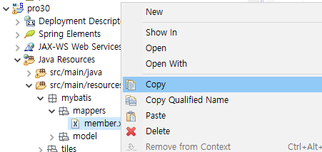
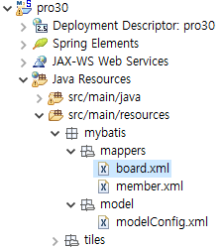
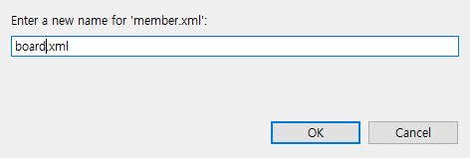
스프링 답변형 게시판
7. src/main/resources/ 패키지에 게시판 기능 관련 매퍼 파일인 마이바티스 관련 board.xml을 추가
- member.xml 위에서 마우스 오른쪽 버튼을 클릭한 후 Copy를 선택하고 다시 Paste를 선택
- 복사한 member.xml의 파일 이름을 board.xml로 변경한 후 OK를 클릭

Slide 16
스프링 답변형 게시판
8. board.xml 기존 파일 내용을 삭제한 후 <select> 태그로 id가 selectAllArticlesList인 SQL문을 추가
<?xml version="1.0" encoding="UTF-8" ?>
<!DOCTYPE mapper
PUBLIC "-//mybatis.org//DTD Mapper 3.0//EN"
"http://mybatis.org/dtd/mybatis-3-mapper.dtd">
<mapper namespace="mapper.board">
<resultMap id="articlesResult" type="articleVO">
<result property="level" column="level" />
<result property="articleNO" column="articleNO" />
<result property="parentNO" column="parentNO" />
<result property="title" column="title" />
<result property="content" column="content" />
<result property="writeDate" column="writeDate" />
<result property="imageFileName" column="imageFileName" />
</resultMap>
<select id="selectAllArticlesList" resultMap="articlesResult" >
<![CDATA[
SELECT level, articleNO, parentNO, title, content, writeDate, imageFileName, id
from t_board
START WITH parentNO=0
CONNECT BY PRIOR articleNO=parentNO
ORDER SIBLINGS BY articleNO DESC
]]>
</select>
</mapper>

Slide 17
스프링 답변형 게시판
9. modelConfig.xml에는 매퍼 파일에서 사용할 articleVO를 추가
<?xml version="1.0" encoding="UTF-8" ?>
<!DOCTYPE configuration PUBLIC "-//mybatis.org//DTD Config 3.0//EN"
"http://mybatis.org/dtd/mybatis-3-config.dtd">
<configuration>
<typeAliases>
<typeAlias type="com.myspring.pro30.member.vo.MemberVO" alias="memberVO" />
<typeAlias type="com.myspring.pro30.board.vo.ArticleVO" alias="articleVO" />
</typeAliases>
</configuration>

Slide 18
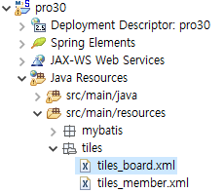
스프링 답변형 게시판
10. tiles_member.xml을 복사해 붙여 넣은 후 파일 이름을 tiles_board.xml로 변경하여 타일즈 설정하기
- 기존 내용을 삭제한 후 게시판 화면 기능은 tiles_board.xml에 설정해서 사용
<?xml version="1.0" encoding="UTF-8" ?>
<!DOCTYPE tiles-definitions PUBLIC
"-//Apache Software Foundation//DTD Tiles Configuration 2.0//EN"
"http://tiles.apache.org/dtds/tiles-config_2_0.dtd">
<tiles-definitions>
<definition name="/board/listArticles" extends="baseLayout">
<put-attribute name="title" value="글목록창" />
<put-attribute name="body" value="/WEB-INF/views/board/listArticles.jsp" />
</definition>
</tiles-definitions>
.글목록창
.글쓰기창
.글상세창

Slide 19
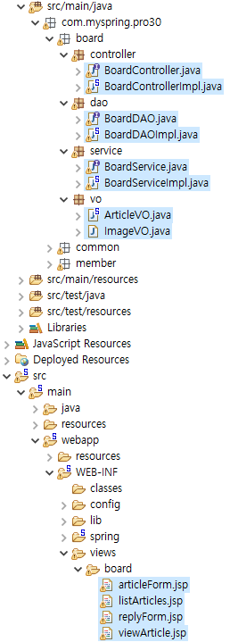
스프링 답변형 게시판
11. 먼저 src/main/java 패키지 하위에 board 패키지를 만든 후 그림 30-8처럼 패키지를 구성
그리고 JSP는 17장에서 실습한 게시판 관련 JSP 파일을 재사용할 것이므로 프로젝트 pro17의 board07
폴더에 있는 JSP 파일을 모두 복사해 views/board 폴더에 붙여 넣기

Slide 20
스프링 답변형 게시판
12. 컨트롤러 클래스인 BoardControllerImpl를 다음과 같이 작성. 브라우저에서 요청하면 모든 글
정보를 조회한 후 ModelAndView 객체에 바인딩하여 JSP로 전달.
package com.myspring.pro30.board.controller;
import java.io.File;
import java.util.ArrayList;
import java.util.Enumeration;
import java.util.HashMap;
import java.util.Iterator;
import java.util.List;
import java.util.Map;
import javax.servlet.http.HttpServletRequest;
import javax.servlet.http.HttpServletResponse;
import javax.servlet.http.HttpSession;
import org.apache.commons.io.FileUtils;
import org.springframework.beans.factory.annotation.Autowired;
import org.springframework.context.annotation.EnableAspectJAutoProxy;
import org.springframework.http.HttpHeaders;
import org.springframework.http.HttpStatus;
import org.springframework.http.ResponseEntity;
import org.springframework.stereotype.Controller;
import org.springframework.web.bind.annotation.RequestMapping;
import org.springframework.web.bind.annotation.RequestMethod;
import org.springframework.web.bind.annotation.RequestParam;
import org.springframework.web.bind.annotation.ResponseBody;
import org.springframework.web.multipart.MultipartFile;
import org.springframework.web.multipart.MultipartHttpServletRequest;
import org.springframework.web.servlet.ModelAndView;
import com.myspring.pro30.board.service.BoardService;
import com.myspring.pro30.board.vo.ArticleVO;
import com.myspring.pro30.board.vo.ImageVO;
import com.myspring.pro30.member.vo.MemberVO;

Slide 21
스프링 답변형 게시판
@Controller("boardController")
public class BoardControllerImpl implements BoardController{
private static final String ARTICLE_IMAGE_REPO = "C:\\board\\article_image";
@Autowired
private BoardService boardService;
@Autowired
private ArticleVO articleVO;
@Override
@RequestMapping(value= "/board/listArticles.do", method = {RequestMethod.GET, RequestMethod.POST})
public ModelAndView listArticles(HttpServletRequest request, HttpServletResponse response) throws Exception {
String viewName = (String)request.getAttribute("viewName");
List articlesList = boardService.listArticles();
ModelAndView mav = new ModelAndView(viewName);
mav.addObject("articlesList", articlesList);
return mav;
}
}
30.2 마이바티스 관련 XML 설정하기

Slide 22
스프링 답변형 게시판
13. 서비스 클래스에서는 boardDAO의 selectAllArticlesList() 메서드를 호출
package com.myspring.pro30.board.service;
import java.util.HashMap;
import java.util.List;
import java.util.Map;
import org.springframework.beans.factory.annotation.Autowired;
import org.springframework.stereotype.Service;
import org.springframework.transaction.annotation.Propagation;
import org.springframework.transaction.annotation.Transactional;
import com.myspring.pro30.board.dao.BoardDAO;
import com.myspring.pro30.board.vo.ArticleVO;
import com.myspring.pro30.board.vo.ImageVO;
@Service("boardService")
@Transactional(propagation = Propagation.REQUIRED)
public class BoardServiceImpl implements BoardService{
@Autowired
BoardDAO boardDAO;
public List<ArticleVO> listArticles() throws Exception{
List<ArticleVO> articlesList = boardDAO.selectAllArticlesList();
return articlesList;
}
}

Slide 23
스프링 답변형 게시판
14. DAO 클래스는 다시 매퍼 파일인 board.xml에서 지정한 id로 SQL문을 실행
package com.myspring.pro30.board.dao;
import java.util.ArrayList;
import java.util.List;
import java.util.Map;
import org.apache.ibatis.session.SqlSession;
import org.springframework.beans.factory.annotation.Autowired;
import org.springframework.dao.DataAccessException;
import org.springframework.stereotype.Repository;
import com.myspring.pro30.board.vo.ArticleVO;
import com.myspring.pro30.board.vo.ImageVO;
@Repository("boardDAO")
public class BoardDAOImpl implements BoardDAO {
@Autowired
private SqlSession sqlSession;
@Override
public List selectAllArticlesList() throws DataAccessException {
List<ArticleVO> articlesList = sqlSession.selectList("mapper.board.selectAllArticlesList");
return articlesList;
}
}

Slide 24
스프링 답변형 게시판
15. 글 정보를 저장할 ArticleVO 클래스를 다음과 같이 작성
package com.myspring.pro30.board.vo;
import java.io.UnsupportedEncodingException;
import java.net.URLDecoder;
import java.net.URLEncoder;
import java.sql.Date;
import org.springframework.stereotype.Component;
@Component("articleVO")
public class ArticleVO {
private int level;
private int articleNO;
private int parentNO;
private String title;
private String content;
private String imageFileName;
private String id;
private Date writeDate;
public ArticleVO() {
System.out.println("ArticleVO 생성자");
}
public int getArticleNO() {
return articleNO;
}
public void setArticleNO(int articleNO) {
this.articleNO = articleNO;
}
public int getParentNO() {
return parentNO;
}

Slide 25
30장 스프링으로 답변형 게시판 만들기
public void setParentNO(int parentNO) {
this.parentNO = parentNO;
}
public int getLevel() {
return level;
}
public void setLevel(int level) {
this.level = level;
}
public String getTitle() {
return title;
}
public void setTitle(String title) {
this.title = title;
}
public String getContent() {
return content;
}
public void setContent(String content) {
this.content = content;
}
public String getImageFileName() {
try {
if (imageFileName != null && imageFileName.length() != 0) {
imageFileName = URLDecoder.decode(imageFileName, "UTF-8");
}
} catch (UnsupportedEncodingException e) {
e.printStackTrace();
30.2 마이바티스 관련 XML 설정하기

Slide 26
30장 스프링으로 답변형 게시판 만들기
}
return imageFileName;
}
public void setImageFileName(String imageFileName) {
try {
if(imageFileName!= null && imageFileName.length()!=0) {
this.imageFileName = URLEncoder.encode(imageFileName,"UTF-8");
}
} catch (UnsupportedEncodingException e) {
e.printStackTrace();
}
}
public String getId() {
return id;
}
public void setId(String id) {
this.id = id;
}
public Date getWriteDate() {
return writeDate;
}
public void setWriteDate(Date writeDate) {
this.writeDate = writeDate;
}
}
30.2 마이바티스 관련 XML 설정하기

Slide 27
스프링 답변형 게시판
16. 글목록창에 해당하는 listArticles.jsp를 작성
<%@ page language="java" contentType="text/html; charset=UTF-8"
pageEncoding="UTF-8" isELIgnored="false" %>
<%@ taglib prefix="fmt" uri="http://java.sun.com/jsp/jstl/fmt" %>
<%@ taglib prefix="c" uri="http://java.sun.com/jsp/jstl/core" %>
<c:set var="contextPath" value="${pageContext.request.contextPath}" />
<%
request.setCharacterEncoding("UTF-8");
%>
<!DOCTYPE html>
<html>
<head>
<style>
.cls1 {text-decoration:none;}
.cls2{text-align:center; font-size:30px;}
</style>
<meta charset="UTF-8">
<title>글목록창</title>
</head>
<body>
<table align="center" border="1" width="80%" >
<tr height="10" align="center" bgcolor="lightgreen">
<td >글번호</td>
<td >작성자</td>
<td >제목</td>
<td >작성일</td>
</tr>
<c:choose>
<c:when test="${articlesList ==null }" >
<tr height="10">
<td colspan="4">
<p align="center">
<b><span style="font-size:9pt;">등록된 글이 없습니다.</span></b>
</p>

Slide 28
스프링 답변형 게시판
</td>
</tr>
</c:when>
<c:when test="${articlesList !=null }" >
<c:forEach var="article" items="${articlesList }" varStatus="articleNum" >
<tr align="center">
<td width="5%">${articleNum.count}</td>
<td width="10%">${article.id }</td>
<td align='left' width="35%">
<span style="padding-right:30px"></span>
<c:choose>
<c:when test='${article.level > 1 }'>
<c:forEach begin="1" end="${article.level }" step="1">
<span style="padding-left:20px"></span>
</c:forEach>
<span style="font-size:12px;">[답변]</span>
<a class='cls1' href="${contextPath}/board/viewArticle.do?articleNO=${article.articleNO}">${article.title}</a>
</c:when>
<c:otherwise>
<a class='cls1' href="${contextPath}/board/viewArticle.do?articleNO=${article.articleNO}">${article.title }</a>
</c:otherwise>
</c:choose>
</td>
<td width="10%">${article.writeDate}</td>
</tr>
</c:forEach>
</c:when>
</c:choose>
</table>
</body>
</html>
30.2 마이바티스 관련 XML 설정하기

Slide 29
스프링 답변형 게시판
17. 왼쪽 메뉴의 각 항목을 클릭할 경우 해당 목록창으로 이동하도록 side.jsp 작성
<%@ page language="java" contentType="text/html; charset=UTF-8"
pageEncoding="UTF-8"
isELIgnored="false" %>
<%@ taglib prefix="fmt" uri="http://java.sun.com/jsp/jstl/fmt" %>
<%@ taglib prefix="c" uri="http://java.sun.com/jsp/jstl/core" %>
<%
request.setCharacterEncoding("UTF-8");
%>
<c:set var="contextPath" value="${pageContext.request.contextPath}" />
<!DOCTYPE html>
<html>
<head>
<style>
.no-underline{
text-decoration:none;
}
</style>
<meta charset="UTF-8">
<title>사이드 메뉴</title>
</head>
<body>
<h1>사이드 메뉴</h1>
<h1>
<a href="${contextPath}/member/listMembers.do" class="no-underline">회원관리</a><br>
<a href="${contextPath}/board/listArticles.do" class="no-underline">게시판관리</a><br>
<a href="#" class="no-underline">상품관리</a><br>
</h1>
</body>
</html>

Slide 30
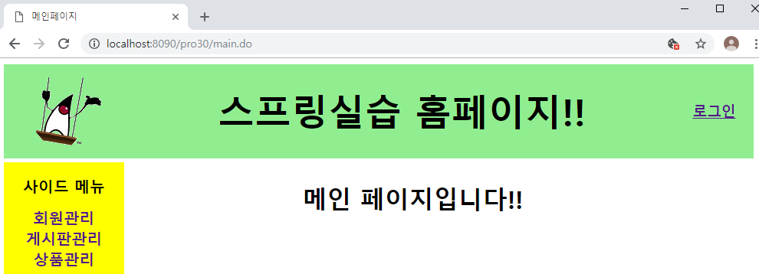
스프링 답변형 게시판
18. http://localhost:8090/pro30/main.do로 요청하면 메인 페이지가 나타남
- 왼쪽 메뉴에 있는 게시판관리를 클릭하면 글목록창이 나타남

Slide 31
스프링 답변형 게시판
19. 게시판 새글 추가하기에 관련한 환경설정하기
- 파일 업로드와 관련된 pom.xml에 파일 첨부 기능과 관련된 라이브러리를 설정
<!-- 파일 업로드 -->
<dependency>
<groupId>commons-fileupload</groupId>
<artifactId>commons-fileupload</artifactId>
<version>1.2.1</version>
</dependency>
<dependency>
<groupId>commons-io</groupId>
<artifactId>commons-io</artifactId>
<version>1.4</version>
</dependency>
- servlet-context.xml에 다중 파일 업로드 기능을 위한 멀티파트 리졸버 빈을 설정합니다.
<!-- 멀티파트 리졸버 -->
<beans:bean id="multipartResolver"
class="org.springframework.web.multipart.commons.CommonsMultipartResolver">
<beans:property name="maxUploadSize" value="52428800" />
<beans:property name="maxInMemorySize" value="52428800" />
<beans:property name="defaultEncoding" value="utf-8" />
</beans:bean>
</beans:beans>

Slide 32
스프링 답변형 게시판
20. 매퍼 파일인 board.xml에 새 글 추가 기능에 사용할 insert문을 작성
<?xml version="1.0" encoding="UTF-8" ?>
<!DOCTYPE mapper PUBLIC "-//mybatis.org//DTD Mapper 3.0//EN"
"http://mybatis.org/dtd/mybatis-3-mapper.dtd">
<mapper namespace="mapper.board">
<resultMap id="articlesResult" type="articleVO">
<result property="level" column="level" />
<result property="articleNO" column="articleNO" />
<result property="parentNO" column="parentNO" />
<result property="title" column="title" />
<result property="content" column="content" />
<result property="writeDate" column="writeDate" />
<result property="imageFileName" column="imageFileName" />
</resultMap>
<select id="selectAllArticlesList" resultMap="articlesResult" >
<![CDATA[
SELECT level, articleNO, parentNO, title, content, writeDate, imageFileName, id
from t_board
START WITH parentNO=0
CONNECT BY PRIOR articleNO=parentNO
ORDER SIBLINGS BY articleNO DESC
]]>
</select>
<!--단일이미지 추가 -->
<insert id="insertNewArticle" parameterType="java.util.Map">
<![CDATA[
INSERT into t_board(articleNO, title, content, imageFileName, id)
VALUES(#{articleNO},#{title},#{content}, #{imageFileName}, #{id})
]]>
</insert>
DB에서 nvl(a, b) 함수는 만약 a의 값이 NULL 이라면 b의 값을 반환하고, a가 NULL이 아니면
그냥 a의 값을 반환한다.
따라서 가장 큰 글번호(articleNO)가 만약 null이면 0으로 반환한다. 최종적으로 1이 된다. 글번호가 null이란 것은 db 테이블 생성 시 레코드 없이 테이블이 생성된 상태에서 프로젝트를 진행하면 발생할 수 있는 일이다. 혹은 게시판 글을 모두 삭제할 경우 해당된다.
30.5 새 글 추가하기
오류가 발생하면
SELECT max(articleNO)+1 from t_board
<select id="selectNewArticleNO" resultType="int" >
<![CDATA[
SELECT nvl(max(articleNO), 0) + 1 from t_board
]]>
</select>

Slide 33
스프링 답변형 게시판
21. 글쓰기창을 타일즈 파일인 tiles_board.xml에 설정
<?xml version="1.0" encoding="UTF-8" ?>
<!DOCTYPE tiles-definitions PUBLIC
"-//Apache Software Foundation//DTD Tiles Configuration 2.0//EN"
"http://tiles.apache.org/dtds/tiles-config_2_0.dtd">
<tiles-definitions>
<definition name="/board/listArticles" extends="baseLayout">
<put-attribute name="title" value="글목록창" />
<put-attribute name="body" value="/WEB-INF/views/board/listArticles.jsp" />
</definition>
<definition name="/board/articleForm" extends="baseLayout">
<put-attribute name="title" value="글쓰기창" />
<put-attribute name="body" value="/WEB-INF/views/board/articleForm.jsp" />
</definition>
</tiles-definitions>

Slide 34
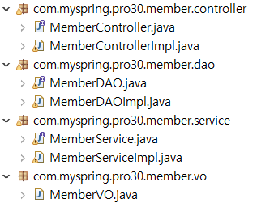
스프링 답변형 게시판
22. 자바 클래스 구현하기
글쓰기 시 로그인 과정 / 회원관리에서 로그인 코드 구현해서, 로그인 성공하면 글쓰기창으로
글목록창(listArticles.jsp) 요청 시 미리 세션의 isLogOn 속성을 자바스크립트 함수의 인자로 저장합니다.
글쓰기를 클릭하면 자바스크립트 함수에서 isLogOn 속성 값을 체크하여 true가 아니면 memberController로 로그인창을 요청하면서 다음에 수행할 URL을 action 값으로 전송합니다.
memberController는 action 값을 세션에 저장합니다.
로그인창에서 ID와 비밀번호를 입력하여 memberController로 전송한 후 로그인에 성공하면 세션의 action 속성 값을 가져와서 글쓰기창으로 바로 이동합니다.
➋에서 isLogOn 속성이 true이면 바로 글쓰기창으로 이동합니다.
pro27 코드를 복사하여 수정한다.

Slide 35
스프링 답변형 게시판
23. MemberControllerImpl 클래스 작성하기 / 로그인 코드 삽입 - 앞서 6.번에 전체 코드
@Override
@RequestMapping(value = "/member/login.do", method = RequestMethod.POST)
public ModelAndView login(@ModelAttribute("member") MemberVO member,
RedirectAttributes rAttr,
HttpServletRequest request, HttpServletResponse response) throws Exception {
ModelAndView mav = new ModelAndView();
memberVO = memberService.login(member);
if(memberVO != null) {
HttpSession session = request.getSession();
session.setAttribute("member", memberVO);
session.setAttribute("isLogOn", true);
String action = (String)session.getAttribute("action");
session.removeAttribute("action");
if(action!= null) {
mav.setViewName("redirect:"+action);
}else {
mav.setViewName("redirect:/member/listMembers.do");
}
}else {
rAttr.addAttribute("result","loginFailed");
mav.setViewName("redirect:/member/loginForm.do");
}
return mav;
}
@Override
@RequestMapping(value = "/member/logout.do", method = RequestMethod.GET)
public ModelAndView logout(HttpServletRequest request, HttpServletResponse response) throws Exception {
HttpSession session = request.getSession();
session.removeAttribute("member");
session.removeAttribute("isLogOn");
ModelAndView mav = new ModelAndView();
mav.setViewName("redirect:/member/listMembers.do");
return mav;
}
30.5 새 글 추가하기
3. 매퍼 파일인 board.xml에 새 글 추가 기능에 사용할 insert문을 작성합니다.
글목록창(listArticles.jsp) 요청 시 미리 세션의 isLogOn 속성을 자바스크립트 함수의 인자로 저장합니다.
글쓰기를 클릭하면 자바스크립트 함수에서 isLogOn 속성 값을 체크하여 true가 아니면 memberController로 로그인창을 요청하면서 다음에 수행할 URL을 action 값으로 전송합니다.
memberController는 action 값을 세션에 저장합니다.
로그인창에서 ID와 비밀번호를 입력하여 memberController로 전송한 후 로그인에 성공하면 세션의 action 속성 값을 가져와서 글쓰기창으로 바로 이동합니다.
➋에서 isLogOn 속성이 true이면 바로 글쓰기창으로 이동합니다.

Slide 36
스프링 답변형 게시판
@Override
@RequestMapping(value = "/member/logout.do", method = RequestMethod.GET)
public ModelAndView logout(HttpServletRequest request, HttpServletResponse response) throws Exception {
HttpSession session = request.getSession();
session.removeAttribute("member");
session.removeAttribute("isLogOn");
ModelAndView mav = new ModelAndView();
mav.setViewName("redirect:/member/listMembers.do");
return mav;
}
@RequestMapping(value = "/member/*Form.do", method = RequestMethod.GET)
private ModelAndView form(@RequestParam(value= "result", required=false) String result,
@RequestParam(value= "action", required=false) String action,
HttpServletRequest request,
HttpServletResponse response) throws Exception {
String viewName = (String)request.getAttribute("viewName");
HttpSession session = request.getSession();
session.setAttribute("action", action);
ModelAndView mav = new ModelAndView();
mav.addObject("result",result);
mav.setViewName(viewName);
return mav;
}
30.5 새 글 추가하기
3. 매퍼 파일인 board.xml에 새 글 추가 기능에 사용할 insert문을 작성합니다.
로그인 후 수행할 글쓰기 요청명을 action에 저장
로그인 성공 후 바로 글쓰기창으로 이동
글쓰기창 요청명을 action 속성으로 세션에 저장
.글쓰기창 articleForm.jsp
.답글창 replyForm.jsp

Slide 37
스프링 답변형 게시판
24. 이번에는 글쓰기 기능을 구현할 BoardControllerImpl 클래스를 작성합니다.
package com.myspring.pro30.board.controller;
import java.io.File;
import java.util.ArrayList;
import java.util.Enumeration;
import java.util.HashMap;
import java.util.Iterator;
import java.util.List;
import java.util.Map;
import javax.servlet.http.HttpServletRequest;
import javax.servlet.http.HttpServletResponse;
import javax.servlet.http.HttpSession;
import org.apache.commons.io.FileUtils;
import org.springframework.beans.factory.annotation.Autowired;
import org.springframework.context.annotation.EnableAspectJAutoProxy;
import org.springframework.http.HttpHeaders;
import org.springframework.http.HttpStatus;
import org.springframework.http.ResponseEntity;
import org.springframework.stereotype.Controller;
import org.springframework.web.bind.annotation.RequestMapping;
import org.springframework.web.bind.annotation.RequestMethod;
import org.springframework.web.bind.annotation.RequestParam;
import org.springframework.web.bind.annotation.ResponseBody;
import org.springframework.web.multipart.MultipartFile;
import org.springframework.web.multipart.MultipartHttpServletRequest;
import org.springframework.web.servlet.ModelAndView;
import com.myspring.pro30.board.service.BoardService;
import com.myspring.pro30.board.vo.ArticleVO;
import com.myspring.pro30.board.vo.ImageVO;
import com.myspring.pro30.member.vo.MemberVO;

Slide 38
스프링 답변형 게시판
@Controller("boardController")
public class BoardControllerImpl implements BoardController{
private static final String ARTICLE_IMAGE_REPO = "C:\\board\\article_image";
@Autowired
private BoardService boardService;
@Autowired
private ArticleVO articleVO;
@Override
@RequestMapping(value= "/board/listArticles.do", method = {RequestMethod.GET, RequestMethod.POST})
public ModelAndView listArticles(HttpServletRequest request, HttpServletResponse response) throws Exception {
String viewName = (String)request.getAttribute("viewName");
List articlesList = boardService.listArticles();
ModelAndView mav = new ModelAndView(viewName);
mav.addObject("articlesList", articlesList);
return mav;
}
30.5 새 글 추가하기

Slide 39
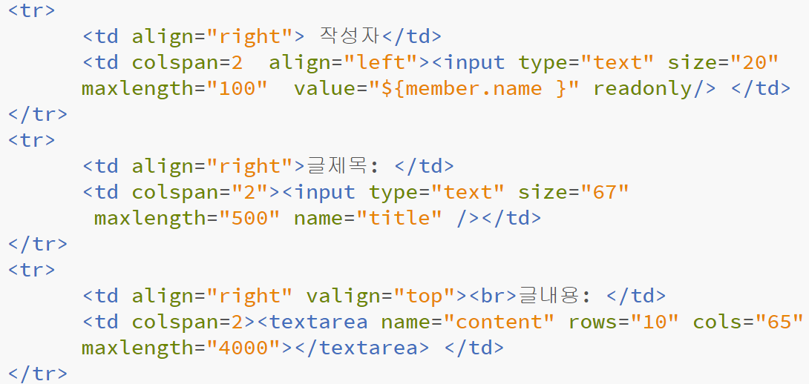
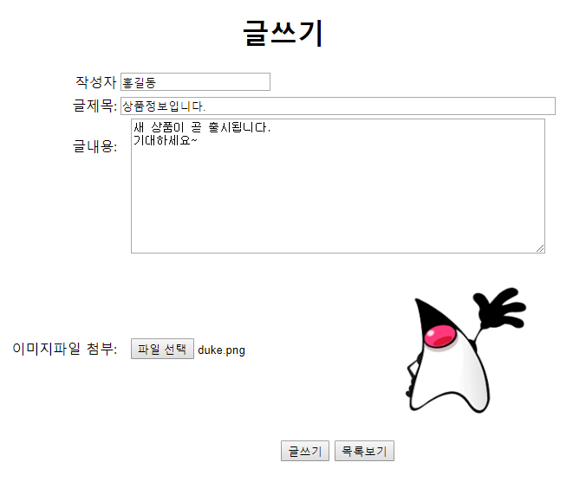
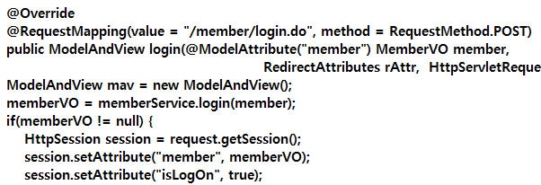
스프링 답변형 게시판
//한 개 이미지 글쓰기
@Override
@RequestMapping(value="/board/addNewArticle.do" ,method = RequestMethod.POST)
@ResponseBody
public ResponseEntity addNewArticle(MultipartHttpServletRequest multipartRequest,
HttpServletResponse response) throws Exception {
multipartRequest.setCharacterEncoding("utf-8");
Map<String,Object> articleMap = new HashMap<String, Object>();
Enumeration enu=multipartRequest.getParameterNames();
while(enu.hasMoreElements()){
String name=(String)enu.nextElement();
String value=multipartRequest.getParameter(name);
articleMap.put(name,value);
}
String imageFileName= upload(multipartRequest);
HttpSession session = multipartRequest.getSession();
MemberVO memberVO = (MemberVO) session.getAttribute("member");
String id = memberVO.getId();
articleMap.put("parentNO", 0);
articleMap.put("id", id);
articleMap.put("imageFileName", imageFileName);
String message;
ResponseEntity resEnt=null;
HttpHeaders responseHeaders = new HttpHeaders();
responseHeaders.add("Content-Type", "text/html; charset=utf-8");
30.5 새 글 추가하기
articleForm.jsp
memberControllerImpl

Slide 40
스프링 답변형 게시판
try {
int articleNO = boardService.addNewArticle(articleMap);
if(imageFileName!=null && imageFileName.length()!=0) {
File srcFile = new
File(ARTICLE_IMAGE_REPO+"\\"+"temp"+"\\"+imageFileName);
File destDir = new File(ARTICLE_IMAGE_REPO+"\\"+articleNO);
FileUtils.moveFileToDirectory(srcFile, destDir,true);
}
message = "<script>";
message += " alert('새글을 추가했습니다.');";
message += " location.href='"+multipartRequest.getContextPath()+"/board/listArticles.do'; ";
message +=" </script>";
resEnt = new ResponseEntity(message, responseHeaders, HttpStatus.CREATED);
}catch(Exception e) {
File srcFile = new File(ARTICLE_IMAGE_REPO+"\\"+"temp"+"\\"+imageFileName);
srcFile.delete();
message = " <script>";
message +=" alert('오류가 발생했습니다. 다시 시도해 주세요');');";
message +=" location.href='"+multipartRequest.getContextPath()+"/board/articleForm.do'; ";
message +=" </script>";
resEnt = new ResponseEntity(message, responseHeaders, HttpStatus.CREATED);
e.printStackTrace();
}
return resEnt;
}
30.5 새 글 추가하기

Slide 41
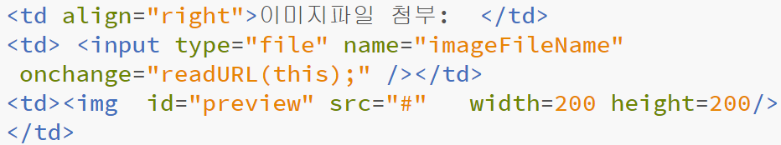
스프링 답변형 게시판
@RequestMapping(value = "/board/*Form.do", method = RequestMethod.GET)
private ModelAndView form(HttpServletRequest request, HttpServletResponse response) throws Exception {
String viewName = (String)request.getAttribute("viewName");
ModelAndView mav = new ModelAndView();
mav.setViewName(viewName);
return mav;
//한개 이미지 업로드하기
private String upload(MultipartHttpServletRequest multipartRequest) throws Exception{
String imageFileName= null;
Iterator<String> fileNames = multipartRequest.getFileNames();
while(fileNames.hasNext()){
String fileName = fileNames.next();
MultipartFile mFile = multipartRequest.getFile(fileName);
imageFileName=mFile.getOriginalFilename();
File file = new File(ARTICLE_IMAGE_REPO +"\\"+ fileName);
if(mFile.getSize()!=0){ //File Null Check
if(! file.exists()){ //경로상에 파일이 존재하지 않을 경우
if(file.getParentFile().mkdirs()){ //경로에 해당하는 디렉토리들을 생성
file.createNewFile(); //이후 파일 생성
}
}
mFile.transferTo(new File(ARTICLE_IMAGE_REPO +"\\"+"temp"+ "\\"+imageFileName));
//임시로 저장된 multipartFile을 실제 파일로 전송
}
}
return imageFileName;
}
}
articleForm.jsp

Slide 42
스프링 답변형 게시판
25. Service 클래스 구현.
- 컨트롤러에서 전달된 articleMap을 다시 DAO의 insertNewArticle() 메서드 인자로 전달
package com.myspring.pro30.board.service;
import java.util.HashMap;
import java.util.List;
import java.util.Map;
import org.springframework.beans.factory.annotation.Autowired;
import org.springframework.stereotype.Service;
import org.springframework.transaction.annotation.Propagation;
import org.springframework.transaction.annotation.Transactional;
import com.myspring.pro30.board.dao.BoardDAO;
import com.myspring.pro30.board.vo.ArticleVO;
import com.myspring.pro30.board.vo.ImageVO;
@Service("boardService")
@Transactional(propagation = Propagation.REQUIRED)
public class BoardServiceImpl implements BoardService{
@Autowired
BoardDAO boardDAO;
public List<ArticleVO> listArticles() throws Exception{
List<ArticleVO> articlesList = boardDAO.selectAllArticlesList();
return articlesList;
}
//단일 이미지 추가하기
@Override
public int addNewArticle(Map articleMap) throws Exception{
return boardDAO.insertNewArticle(articleMap);
}
}
2개의 논리단위를 갖는 작업단위

Slide 43
스프링 답변형 게시판
26. DAO에서는 새 글에 대한 글 번호를 조회한 후 전달된 articleMap에 글 번호를 설정
그리고 insert() 메서드를 호출하면서 articleMap을 해당 id의 insert문으로 전달
package com.myspring.pro30.board.dao;
import java.util.ArrayList;
import java.util.List;
import java.util.Map;
import org.apache.ibatis.session.SqlSession;
import org.springframework.beans.factory.annotation.Autowired;
import org.springframework.dao.DataAccessException;
import org.springframework.stereotype.Repository;
import com.myspring.pro30.board.vo.ArticleVO;
import com.myspring.pro30.board.vo.ImageVO;
@Repository("boardDAO")
public class BoardDAOImpl implements BoardDAO {
@Autowired
private SqlSession sqlSession;
@Override
public List selectAllArticlesList() throws DataAccessException {
List<ArticleVO> articlesList = sqlSession.selectList("mapper.board.selectAllArticlesList");
return articlesList;
}
@Override
public int insertNewArticle(Map articleMap) throws DataAccessException {
int articleNO = selectNewArticleNO();
articleMap.put("articleNO", articleNO);
sqlSession.insert("mapper.board.insertNewArticle",articleMap);
return articleNO;
}
private int selectNewArticleNO() throws DataAccessException {
return sqlSession.selectOne("mapper.board.selectNewArticleNO");
}
}

Slide 44
스프링 답변형 게시판
27. listArticles.jsp 구현하기. 글목록창에서 회원 로그인 상태(${isLogOn})를 함수 인자 값으로 미리 저장
글쓰기를 클릭하면 자바스크립트 함수를 호출하면서 로그인 상태 여부에 따라 각각 다른 요청을 수행
<%@ page language="java" contentType="text/html; charset=UTF-8"
pageEncoding="UTF-8"
isELIgnored="false" %>
<%@ taglib prefix="fmt" uri="http://java.sun.com/jsp/jstl/fmt" %>
<%@ taglib prefix="c" uri="http://java.sun.com/jsp/jstl/core" %>
<c:set var="contextPath" value="${pageContext.request.contextPath}" />
<%
request.setCharacterEncoding("UTF-8");
%>
<!DOCTYPE html>
<html>
<head>
<style>
.cls1 {text-decoration:none;}
.cls2{text-align:center; font-size:30px;}
</style>
<meta charset="UTF-8">
<title>글목록창</title>
</head>
<script>
function fn_articleForm(isLogOn,articleForm,loginForm){
if(isLogOn != '' && isLogOn != 'false'){
location.href=articleForm;
}else{
alert("로그인 후 글쓰기가 가능합니다.")
location.href=loginForm+'?action=/board/articleForm.do';
}
}
</script>
글목록창(listArticles.jsp) 요청 시 미리 세션의 isLogOn 속성을 자바스크립트 함수의 인자로 저장합니다.
글쓰기를 클릭하면 자바스크립트 함수에서 isLogOn 속성 값을 체크하여 true가 아니면 memberController로 로그인창을 요청하면서 다음에 수행할 URL을 action 값으로 전송합니다.
memberController는 action 값을 세션에 저장합니다.
로그인창에서 ID와 비밀번호를 입력하여 memberController로 전송한 후 로그인에 성공하면 세션의 action 속성 값을 가져와서 글쓰기창으로 바로 이동합니다.
➋에서 isLogOn 속성이 true이면 바로 글쓰기창으로 이동합니다.

Slide 45
스프링 답변형 게시판
<body>
<table align="center" border="1" width="80%" >
<tr height="10" align="center" bgcolor="lightgreen">
<td >글번호</td>
<td >작성자</td>
<td >제목</td>
<td >작성일</td>
</tr>
<c:choose>
<c:when test="${articlesList ==null }" >
<tr height="10">
<td colspan="4">
<p align="center">
<b><span style="font-size:9pt;">등록된 글이 없습니다.</span></b>
</p>
</td>
</tr>
</c:when>
<c:when test="${articlesList !=null }" >
<c:forEach var="article" items="${articlesList }" varStatus="articleNum" >
<tr align="center">
<td width="5%">${articleNum.count}</td>
<td width="10%">${article.id }</td>
<td align='left' width="35%">
<span style="padding-right:30px"></span>
<c:choose>
<c:when test='${article.level > 1 }'>
<c:forEach begin="1" end="${article.level }" step="1">
<span style="padding-left:20px"></span>
</c:forEach>
<span style="font-size:12px;">[답변]</span>
<a class='cls1' href="${contextPath}/board/viewArticle.do?articleNO=${article.articleNO}">${article.title}</a>
</c:when>

Slide 46
스프링 답변형 게시판
<c:otherwise>
<a class='cls1' href="${contextPath}/board/viewArticle.do?articleNO=${article.articleNO}">${article.title }</a>
</c:otherwise>
</c:choose>
</td>
<td width="10%">${article.writeDate}</td>
</tr>
</c:forEach>
</c:when>
</c:choose>
</table>
<!-- <a class="cls1" href="#"><p class="cls2">글쓰기</p></a> -->
<a class="cls1" href="javascript:fn_articleForm('${isLogOn}','${contextPath}/board/articleForm.do',
'${contextPath}/member/loginForm.do')"><p class="cls2">글쓰기</p></a>
</body>
<script>
function fn_articleForm(isLogOn,articleForm,loginForm){
if(isLogOn != '' && isLogOn != 'false'){
location.href=articleForm;
}else{
alert("로그인 후 글쓰기가 가능합니다.")
location.href=loginForm+'?action=/board/articleForm.do';
}
}
</script>

Slide 47
스프링 답변형 게시판
28. articleForm 글쓰기창에서는 글 정보와 함께 이미지 파일을 첨부하여 컨트롤러로 전송
<%@ page language="java" contentType="text/html; charset=UTF-8"
pageEncoding="UTF-8"
isELIgnored="false" %>
<%@ taglib prefix="fmt" uri="http://java.sun.com/jsp/jstl/fmt" %>
<%@ taglib prefix="c" uri="http://java.sun.com/jsp/jstl/core" %>
<c:set var="contextPath" value="${pageContext.request.contextPath}" />
<%
request.setCharacterEncoding("UTF-8");
%>
<head>
<meta charset="UTF-8">
<title>글쓰기창</title>
<script src="http://code.jquery.com/jquery-latest.min.js"></script>
<script type="text/javascript">
function readURL(input) {
if (input.files && input.files[0]) {
var reader = new FileReader();
reader.onload = function (e) {
$('#preview').attr('src', e.target.result);
}
reader.readAsDataURL(input.files[0]);
}
}
function backToList(obj){
obj.action="${contextPath}/board/listArticles.do";
obj.submit();
}

Slide 48
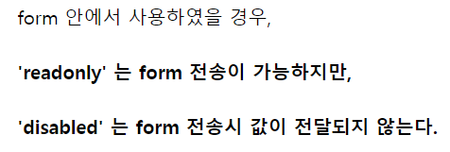
스프링 답변형 게시판
var cnt=1;
function fn_addFile(){
$("#d_file").append("<br>"+"<input type='file' name='file"+cnt+"' />");
cnt++;
}
</script>
<title>글쓰기창</title>
</head>
<body>
<h1 style="text-align:center">글쓰기</h1>
<form name="articleForm" method="post" action="${contextPath}/board/addNewArticle.do" enctype="multipart/form-data">
<table border="0" align="center">
<tr>
<td align="right"> 작성자</td>
<td colspan=2 align="left"><input type="text" size="20" maxlength="100" value="${member.name }" readonly/> </td>
</tr>
<tr>
<td align="right">글제목: </td>
<td colspan="2"><input type="text" size="67" maxlength="500" name="title" /></td>
</tr>
<tr>
<td align="right" valign="top"><br>글내용: </td>
<td colspan=2><textarea name="content" rows="10" cols="65" maxlength="4000"></textarea> </td>
</tr>

Slide 49
스프링 답변형 게시판
<tr>
<td align="right">이미지파일 첨부: </td>
<td> <input type="file" name="imageFileName" onchange="readURL(this);" /></td>
<td><img id="preview" src="#" width=200 height=200/></td>
<td align="right">이미지파일 첨부</td>
<td align="left"> <input type="button" value="파일 추가" onClick="fn_addFile()"/></td>
</tr>
<tr>
<td colspan="4"><div id="d_file"></div></td>
</tr>
<tr>
<td align="right"> </td>
<td colspan="2">
<input type="submit" value="글쓰기" />
<input type=button value="목록보기"onClick="backToList(this.form)" />
</td>
</tr>
</table>
</form>
</body>
</html>

Slide 50
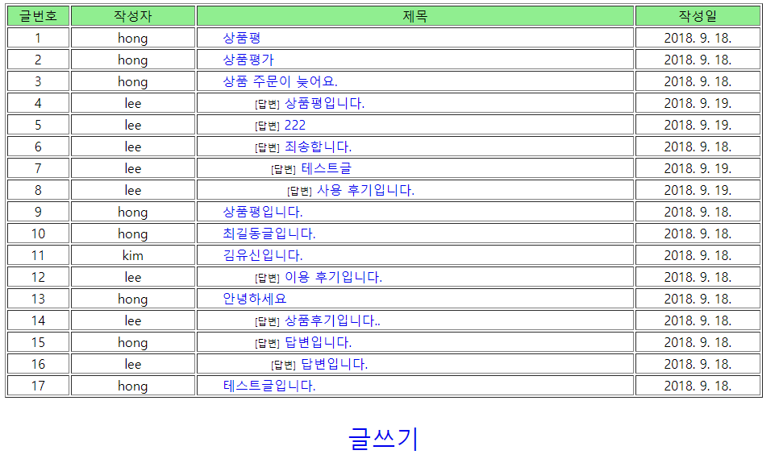
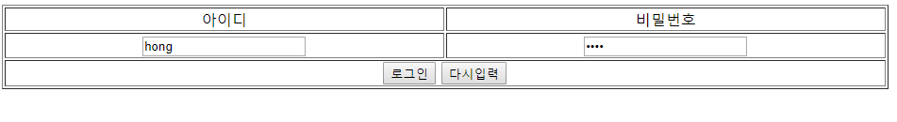
스프링 답변형 게시판
29. 브라우저로 요청하여 글목록창을 나타낸 후 글쓰기를 클릭
- 로그인 상태가 아닐 경우 로그인창으로 이동하여 로그인을 클릭

Slide 51
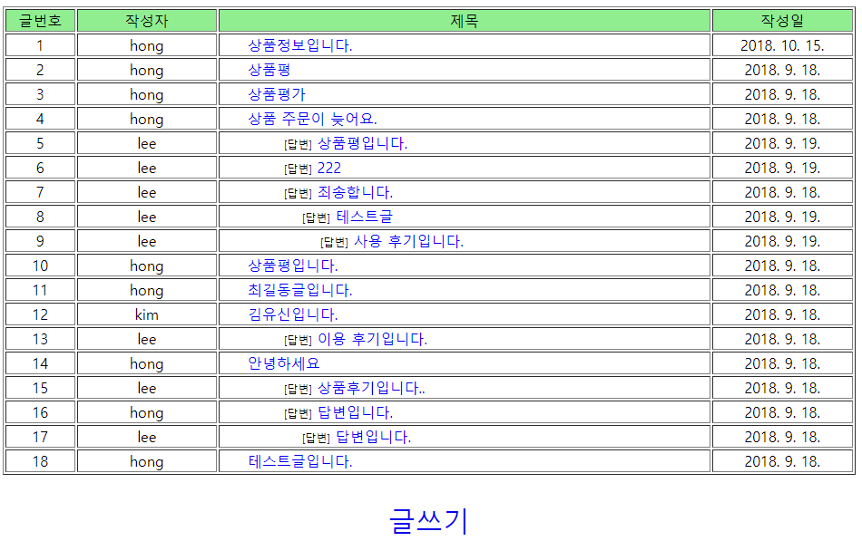
스프링 답변형 게시판
30. 글쓰기. 로그인에 성공하면 다시 글쓰기창으로 이동하여 글 정보를 입력하고 글쓰기를 클릭

Slide 52
스프링 답변형 게시판
31. 글상세창 구현.
- 매퍼 파일 board.xml에 전달된 글 번호에 대해 글 정보를 조회하는 SQL문을 추가합니다.
<select id="selectNewArticleNO" resultType="int" >
<![CDATA[
SELECT nvl(max(articleNO), 0) + 1 from t_board
]]>
</select>
<select id="selectArticle" resultType="articleVO" parameterType="int">
<![CDATA[
SELECT * from t_board
where articleNO = #{articleNO}
]]>
</select>
- 글상세창(viewArticle.jsp)을 나타낼 타일즈 기능을 설정 tiles_board.xml
<definition name="/board/articleForm" extends="baseLayout">
<put-attribute name="title" value="글쓰기창" />
<put-attribute name="body" value="/WEB-INF/views/board/articleForm.jsp" />
</definition>
<definition name="/board/viewArticle" extends="baseLayout">
<put-attribute name="title" value="글상세창" />
<put-attribute name="body" value="/WEB-INF/views/board/viewArticle.jsp" />
</definition>
</tiles-definitions>

Slide 53
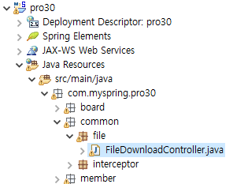
스프링 답변형 게시판
32. 첨부 파일을 표시할 파일 다운로드 컨트롤러인 FileDownloadController를 common/file 패키지에 구현
package com.myspring.pro30.common.file;
import java.io.File;
import java.io.FileInputStream;
import java.io.IOException;
import java.io.OutputStream;
import javax.servlet.ServletException;
import javax.servlet.http.HttpServletResponse;
import org.springframework.stereotype.Controller;
import org.springframework.web.bind.annotation.RequestMapping;
import org.springframework.web.bind.annotation.RequestParam;

Slide 54
스프링 답변형 게시판
33. FileDownloadController 클래스를 28장에서 복사해 붙여 넣은 후 다음과 같이 수정
@Controller
public class FileDownloadController {
private static final String ARTICLE_IMAGE_REPO = "C:\\board\\article_image";
@RequestMapping("/download.do")
protected void download(@RequestParam("imageFileName") String imageFileName,
@RequestParam("articleNO") String articleNO,
HttpServletResponse response)throws Exception {
OutputStream out = response.getOutputStream();
String downFile = ARTICLE_IMAGE_REPO + "\\" +articleNO+"\\"+ imageFileName;
File file = new File(downFile);
response.setHeader("Cache-Control", "no-cache");
response.addHeader("Content-disposition", "attachment; fileName=" + imageFileName);
FileInputStream in = new FileInputStream(file);
byte[] buffer = new byte[1024 * 8];
while (true) {
int count = in.read(buffer);
if (count == -1)
break;
out.write(buffer, 0, count);
}
in.close();
out.close();
}
}

Slide 55
스프링 답변형 게시판
34. BoardControllerImpl.java 글목록창에서 전달된 글 번호를 이용하여 해당 글 정보를 조회
//한개의 이미지 보여주기
@RequestMapping(value="/board/viewArticle.do" ,method = RequestMethod.GET)
public ModelAndView viewArticle(@RequestParam("articleNO") int articleNO,
HttpServletRequest request, HttpServletResponse response) throws Exception{
String viewName = (String)request.getAttribute("viewName");
articleVO=boardService.viewArticle(articleNO);
ModelAndView mav = new ModelAndView();
mav.setViewName(viewName);
mav.addObject("article", articleVO);
return mav;
}
35. Service 클래스와 DAO 클래스의 메서드
//단일 파일 보이기
@Override
public ArticleVO viewArticle(int articleNO) throws Exception {
ArticleVO articleVO = boardDAO.selectArticle(articleNO);
return articleVO;
}
@Override
public ArticleVO selectArticle(int articleNO) throws DataAccessException {
return sqlSession.selectOne("mapper.board.selectArticle", articleNO);
}

Slide 56
스프링 답변형 게시판
36. 글 상세 정보를 표시할 viewArticle.jsp 파일을 작성. 단, 자신이 작성한 글만 수정, 삭제를 표시
<tr id="tr_btn" >
<td colspan="2" align="center">
<c:if test="${member.id == article.id }">
<input type=button value="수정하기" onClick="fn_enable(this.form)">
<input type=button value="삭제하기" onClick="fn_remove_article('${contextPath}/board/removeArticle.do', ${article.articleNO})">
</c:if>
<input type=button value="리스트로 돌아가기" onClick="backToList(this.form)">
<input type=button value="답글쓰기" onClick="fn_reply_form('${contextPath}/board/replyForm.do', ${article.articleNO})">
</td>
</tr>
</table>
</form>
</body>
</html>

Slide 57
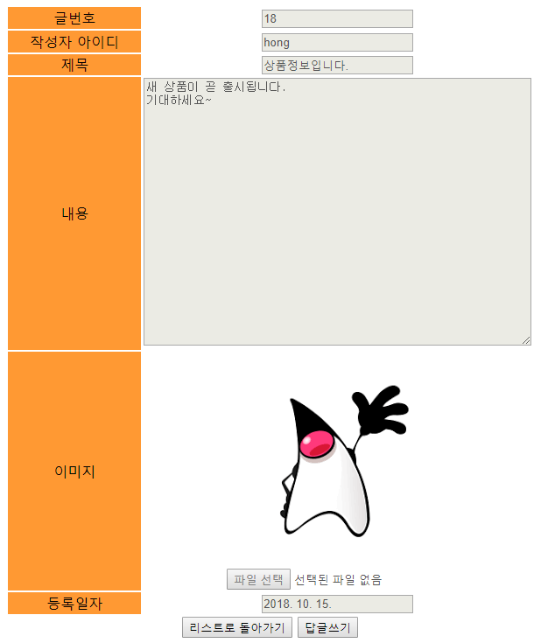
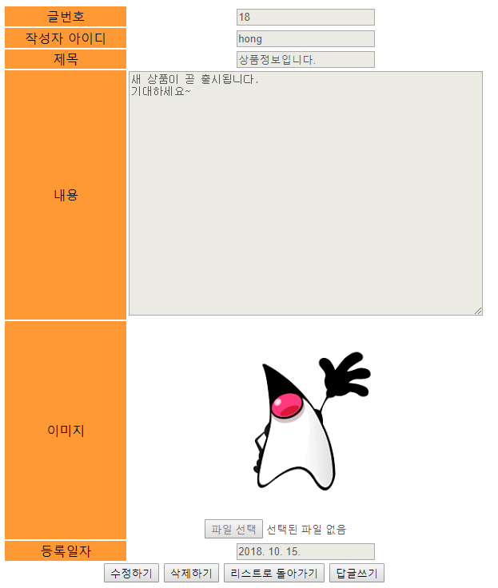
스프링 답변형 게시판
37. 다음은 실행 결과. 로그인하지 않았을 때와 로그인했을 때의 결과가 어떻게 다른지 비교해 보기
로그인했을 때: 수정하기와 삭제하기 버튼이 보임

Slide 58
스프링 답변형 게시판
38. 글 수정하기. board.xml매퍼 파일에 update문을 추가. if문을 사용하여 글 수정 시 이미지를 수정한
경우만 이미지 파일 이름을 업데이트하도록 지정.
<update id="updateArticle" parameterType="java.util.Map">
update t_board
set title=#{title},
content=#{content}
<if test="imageFileName!='' and imageFileName!=null">
, imageFileName=#{imageFileName}
</if>
where articleNO=#{articleNO}
</update>
다른 태그에서는 <![CDATA[ ]]> 사용한 것과는 달리 이곳에서는 사용하지 않음
<![CDATA[ Query- ]]> 를 사용하는 이유는 '>', '<', ',', '&' 등의 기호를 사용하기 위해서이다. 특히, < > 의 기호가 xml태그로 인식이 되어서 에러가 나는 경우가 많다.

Slide 59
스프링 답변형 게시판
39. BoardController.java 작성.
//한 개 이미지 수정 기능
@RequestMapping(value="/board/modArticle.do" ,method = RequestMethod.POST)
@ResponseBody
public ResponseEntity modArticle(MultipartHttpServletRequest multipartRequest,
HttpServletResponse response) throws Exception{
multipartRequest.setCharacterEncoding("utf-8");
Map<String,Object> articleMap = new HashMap<String, Object>();
Enumeration enu=multipartRequest.getParameterNames();
while(enu.hasMoreElements()){
String name=(String)enu.nextElement();
String value=multipartRequest.getParameter(name);
articleMap.put(name,value);
}
String imageFileName= upload(multipartRequest);
articleMap.put("imageFileName", imageFileName);
String articleNO=(String)articleMap.get("articleNO");
String message;
ResponseEntity resEnt=null;
HttpHeaders responseHeaders = new HttpHeaders();
responseHeaders.add("Content-Type", "text/html; charset=utf-8");
try {
boardService.modArticle(articleMap);
if(imageFileName!=null && imageFileName.length()!=0) {
File srcFile = new File(ARTICLE_IMAGE_REPO+"\\"+"temp"+"\\"+imageFileName);
File destDir = new File(ARTICLE_IMAGE_REPO+"\\"+articleNO);
FileUtils.moveFileToDirectory(srcFile, destDir, true);
String originalFileName = (String)articleMap.get("originalFileName");
File oldFile = new File(ARTICLE_IMAGE_REPO+"\\"+articleNO+"\\"+originalFileName);
oldFile.delete();
}

Slide 60
스프링 답변형 게시판
message = "<script>";
message += " alert('글을 수정했습니다.');";
message += " location.href='"+multipartRequest.getContextPath()+"/board/viewArticle.do?articleNO="+articleNO+"';";
message +=" </script>";
resEnt = new ResponseEntity(message, responseHeaders, HttpStatus.CREATED);
}catch(Exception e) {
File srcFile = new File(ARTICLE_IMAGE_REPO+"\\"+"temp"+"\\"+imageFileName);
srcFile.delete();
message = "<script>";
message += " alert('오류가 발생했습니다.다시 수정해주세요');";
message += " location.href='"+multipartRequest.getContextPath()+"/board/viewArticle.do?articleNO="+articleNO+"';";
message +=" </script>";
resEnt = new ResponseEntity(message, responseHeaders, HttpStatus.CREATED);
}
return resEnt;
}

Slide 61
스프링 답변형 게시판
40. Service 클래스와 DAO 클래스 구현
@Override
public void modArticle(Map articleMap) throws Exception {
boardDAO.updateArticle(articleMap);
}
@Override
public void updateArticle(Map articleMap) throws DataAccessException {
sqlSession.update("mapper.board.updateArticle", articleMap);
}

Slide 62
스프링 답변형 게시판
41. viewArticle.jsp 첨부 파일이 없는 글을 수정할 때는 파일 업로드 기능이 표시되도록 수정해야 한다
<%@ page language="java" contentType="text/html; charset=UTF-8"
pageEncoding="UTF-8"
isELIgnored="false" %>
<%@ taglib prefix="fmt" uri="http://java.sun.com/jsp/jstl/fmt" %>
<%@ taglib prefix="c" uri="http://java.sun.com/jsp/jstl/core" %>
<c:set var="contextPath" value="${pageContext.request.contextPath}" />
<%--
<c:set var="article" value="${articleMap.article}" />
<c:set var="imageFileList" value="${articleMap.imageFileList}" />
--%>
<%
request.setCharacterEncoding("UTF-8");
%>
<head>
<meta charset="UTF-8">
<title>글보기</title>
<style>
#tr_file_upload{
display:none;
}
#tr_btn_modify{
display:none;
}
</style>
<script src="http://code.jquery.com/jquery-latest.min.js"></script>
<script type="text/javascript" >
function backToList(obj){
obj.action="${contextPath}/board/listArticles.do";
obj.submit();
}
추후 코드: 59. 번에서 추가

Slide 63
스프링 답변형 게시판
function fn_enable(obj){
document.getElementById("i_title").disabled=false;
document.getElementById("i_content").disabled=false;
document.getElementById("i_imageFileName").disabled=false;
document.getElementById("tr_btn_modify").style.display="block";
document.getElementById("tr_file_upload").style.display="block";
document.getElementById("tr_btn").style.display="none";
}
function fn_modify_article(obj){
obj.action="${contextPath}/board/modArticle.do";
obj.submit();
}
function fn_remove_article(url,articleNO){
var form = document.createElement("form");
form.setAttribute("method", "post");
form.setAttribute("action", url);
var articleNOInput = document.createElement("input");
articleNOInput.setAttribute("type","hidden");
articleNOInput.setAttribute("name","articleNO");
articleNOInput.setAttribute("value", articleNO);
form.appendChild(articleNOInput);
document.body.appendChild(form);
form.submit();
}
function fn_reply_form(url, parentNO){
var form = document.createElement("form");
form.setAttribute("method", "post");
form.setAttribute("action", url);
var parentNOInput = document.createElement("input");
parentNOInput.setAttribute("type","hidden");
parentNOInput.setAttribute("name","parentNO");
parentNOInput.setAttribute("value", parentNO);
form.appendChild(parentNOInput);
document.body.appendChild(form);
form.submit();
}
41. viewArticle.jsp 첨부 파일이 없는 글을 수정할 때는 파일 업로드 기능이 표시되도록 수정해야 한다
추후 코드: 다중 이미지

Slide 64
스프링 답변형 게시판
function readURL(input) {
if (input.files && input.files[0]) {
var reader = new FileReader();
reader.onload = function (e) {
$('#preview').attr('src', e.target.result);
}
reader.readAsDataURL(input.files[0]);
}
}
</script>
</head>
<body>
<form name="frmArticle" method="post" action="${contextPath}" enctype="multipart/form-data">
<table border=0 align="center">
<tr>
<td width=150 align="center" bgcolor=#FF9933>
글번호
</td>
<td >
<input type="text" value="${article.articleNO }" disabled />
<input type="hidden" name="articleNO" value="${article.articleNO}" />
</td>
</tr>
<tr>
<td width="150" align="center" bgcolor="#FF9933">
작성자 아이디
</td>
<td >
<input type=text value="${article.id }" name="writer" disabled />
</td>
</tr>
<tr>
<td width="150" align="center" bgcolor="#FF9933">
제목
</td>
<td>
<input type=text value="${article.title }" name="title" id="i_title" disabled />
</td>
</tr>
41. viewArticle.jsp 첨부 파일이 없는 글을 수정할 때는 파일 업로드 기능이 표시되도록 수정해야 한다

Slide 65
스프링 답변형 게시판
<tr>
<td width="150" align="center" bgcolor="#FF9933">
내용
</td>
<td>
<textarea rows="20" cols="60" name="content" id="i_content" disabled />${article.content }</textarea>
</td>
</tr>
<%-- 주석처리해야 함
<c:if test="${not empty imageFileList && imageFileList!='null' }">
<c:forEach var="item" items="${imageFileList}" varStatus="status" >
<tr>
<td width="150" align="center" bgcolor="#FF9933" rowspan="2">
이미지${status.count }
</td>
<td>
<input type= "hidden" name="originalFileName" value="${item.imageFileName }" />
<img src="${contextPath}/download.do?articleNO=${article.articleNO}&imageFileName=${item.imageFileName}" id="preview" /><br>
</td>
</tr>
<tr>
<td>
<input type="file" name="imageFileName " id="i_imageFileName" disabled onchange="readURL(this);" />
</td>
</tr>
</c:forEach>
</c:if>
--%>
41. viewArticle.jsp 첨부 파일이 없는 글을 수정할 때는 파일 업로드 기능이 표시되도록 수정해야 한다
추후 코드: 59. 번에서 추가

Slide 66
스프링 답변형 게시판
<c:choose>
<c:when test="${not empty article.imageFileName && article.imageFileName!='null' }">
<tr>
<td width="150" align="center" bgcolor="#FF9933" rowspan="2">
이미지
</td>
<td>
<input type= "hidden" name="originalFileName" value="${article.imageFileName }" />
<img src="${contextPath}/download.do?articleNO=${article.articleNO}&imageFileName=${article.imageFileName}" id="preview" /><br>
</td>
</tr>
<tr>
<td ></td>
<td>
<input type="file" name="imageFileName " id="i_imageFileName" disabled onchange="readURL(this);" />
</td>
</tr>
</c:when>
<c:otherwise>
<tr id="tr_file_upload" >
<td width="150" align="center" bgcolor="#FF9933" rowspan="2">
이미지
</td>
<td>
<input type= "hidden" name="originalFileName" value="${article.imageFileName }" />
</td>
</tr>
<tr>
<td ></td>
<td>
<img id="preview" /><br>
<input type="file" name="imageFileName " id="i_imageFileName" disabled onchange="readURL(this);" />
</td>
</tr>
</c:otherwise>
</c:choose>
41. viewArticle.jsp 첨부 파일이 없는 글을 수정할 때는 파일 업로드 기능이 표시되도록 수정해야 한다

Slide 67
스프링 답변형 게시판
<tr>
<td width="150" align="center" bgcolor="#FF9933">
등록일자
</td>
<td>
<input type=text value="<fmt:formatDate value="${article.writeDate}" />" disabled />
</td>
</tr>
<tr id="tr_btn_modify" align="center" >
<td colspan="2" >
<input type=button value="수정반영하기" onClick="fn_modify_article(frmArticle)" >
<input type=button value="취소" onClick="backToList(frmArticle)">
</td>
</tr>
<tr id="tr_btn" >
<td colspan="2" align="center">
<c:if test="${member.id == article.id }">
<input type=button value="수정하기" onClick="fn_enable(this.form)">
<input type=button value="삭제하기" onClick="fn_remove_article('${contextPath}/board/removeArticle.do', ${article.articleNO})">
</c:if>
<input type=button value="리스트로 돌아가기" onClick="backToList(this.form)">
<input type=button value="답글쓰기" onClick="fn_reply_form('${contextPath}/board/replyForm.do', ${article.articleNO})">
</td>
</tr>
</table>
</form>
</body>
</html>
41. viewArticle.jsp 첨부 파일이 없는 글을 수정할 때는 파일 업로드 기능이 표시되도록 수정해야 한다

Slide 68
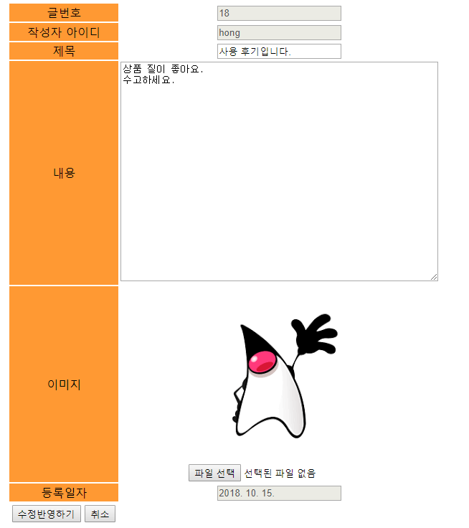
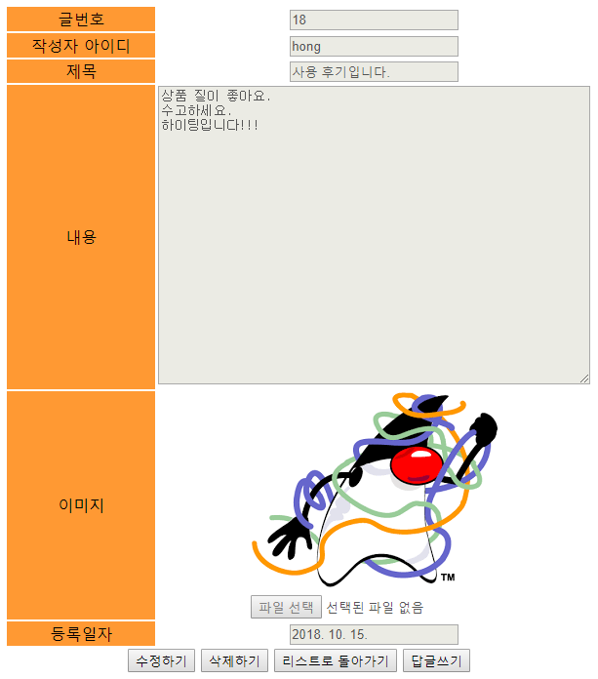
스프링 답변형 게시판
42 다음은 실행 결과. 글상세창에서 수정하기를 클릭하면 글을 수정할 수 있는 상태로 바뀐다.
글 내용과 이미지를 수정한 후 수정반영하기를 클릭
-다음과 같이 수정된 글 정보를 테이블에 반영하고 새로운
이미지를 업로드한 후 다시 글상세창을 나타낸다.

Slide 69
스프링 답변형 게시판
43. 매퍼 파일 board.xml에 글 번호를 가져와 관련된 자식 글까지 삭제하는 delete문을 추가.
<delete id="deleteArticle" parameterType="int">
<![CDATA[
delete from t_board
where articleNO in (
SELECT articleNO FROM t_board
START WITH articleNO = #{articleNO}
CONNECT BY PRIOR articleNO = parentNO )
]]>
</delete>

Slide 70
스프링 답변형 게시판
44. 컨트롤러에서는 글 번호를 가져와 해당 글을 삭제. 그리고 해당되는 이미지가 저장된 폴더도 함께
삭제
@Override
@RequestMapping(value="/board/removeArticle.do" ,method = RequestMethod.POST)
@ResponseBody
public ResponseEntity removeArticle(@RequestParam("articleNO") int articleNO,
HttpServletRequest request, HttpServletResponse response) throws Exception{
response.setContentType("text/html; charset=UTF-8");
String message;
ResponseEntity resEnt=null;
HttpHeaders responseHeaders = new HttpHeaders();
responseHeaders.add("Content-Type", "text/html; charset=utf-8");
try {
boardService.removeArticle(articleNO);
File destDir = new File(ARTICLE_IMAGE_REPO+"\\"+articleNO);
FileUtils.deleteDirectory(destDir);
message = "<script>";
message += " alert('글을 삭제했습니다.');";
message += " location.href='"+request.getContextPath()+"/board/listArticles.do';";
message +=" </script>";
resEnt = new ResponseEntity(message, responseHeaders, HttpStatus.CREATED);
}catch(Exception e) {
message = "<script>";
message += " alert('작업중 오류가 발생했습니다.다시 시도해 주세요.');";
message += " location.href='"+request.getContextPath()+"/board/listArticles.do';";
message +=" </script>";
resEnt = new ResponseEntity(message, responseHeaders, HttpStatus.CREATED);
e.printStackTrace();
}
return resEnt;
}

Slide 71
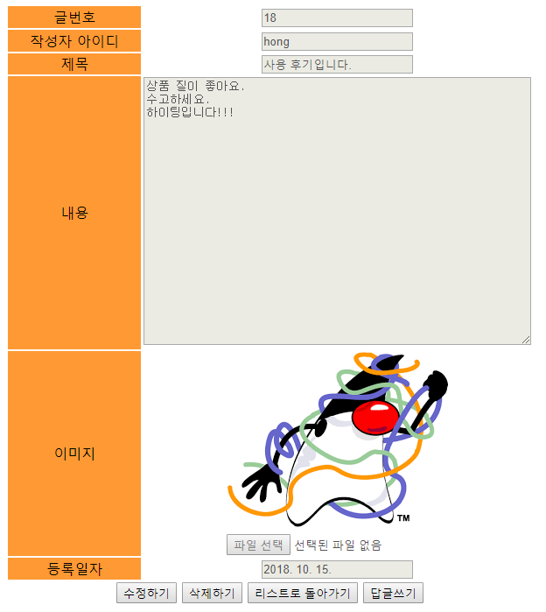
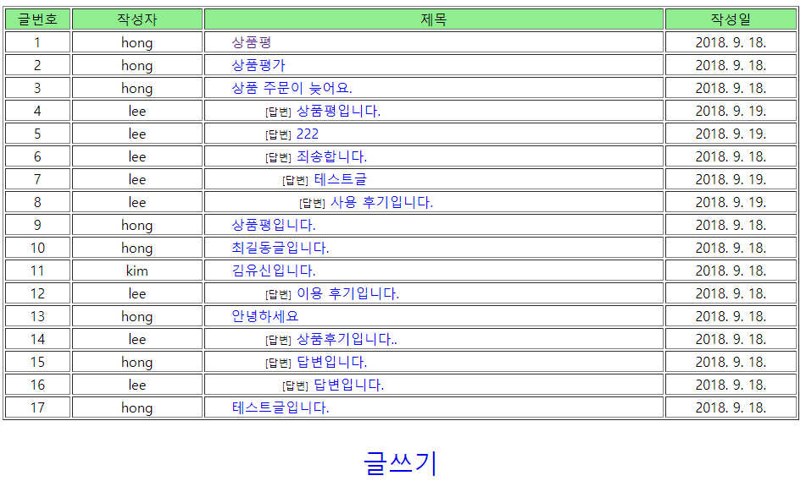
스프링 답변형 게시판
45. Service 클래스와 DAO 클래스 구현
@Override
public void removeArticle(int articleNO) throws Exception {
boardDAO.deleteArticle(articleNO);
}
@Override
public void deleteArticle(int articleNO) throws DataAccessException {
sqlSession.delete("mapper.board.deleteArticle", articleNO);
}
- 해당 글을 삭제한 후 글목록창을 다시 표시

Slide 72
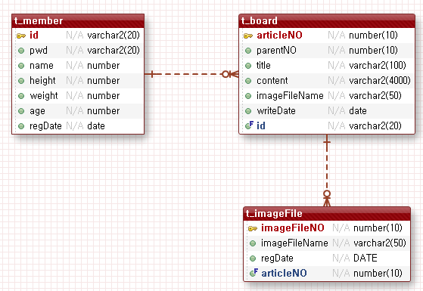
스프링 답변형 게시판
46. 새글 추가 시 여러 이미지 파일 첨부
이미지 정보 테이블 생성

Slide 73
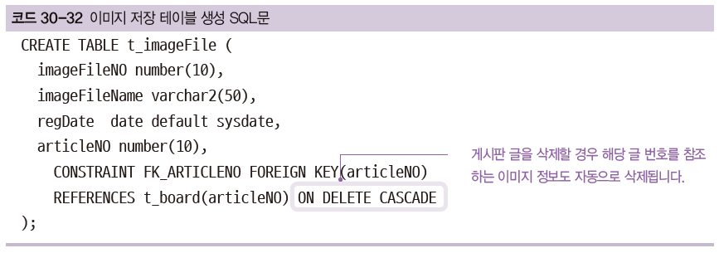
스프링 답변형 게시판
47. SQL Developer를 이용해 이미지 테이블을 생성. SQL문 실행 시 마지막에 게시판 테이블의 articleNO
컬럼을 참조하는 구문을 추가
이미지 정보 테이블 구조
no | 컬럼이름 | 속성 이름 | 자료형 | 크기 | 유일키 여부 | NULL 여부 | 키 | 기본값
1 | imageFileNO | 이미지 파일 번호 | number | 10 | Y | N | 기본키
2 | imageFileName | 이미지 파일 이름 | varchar2 | 50 | N | N
3 | regData | 등록일자 | date |  | N | N |  | sysdate
4 | articleNO | 글 번호 | number | 10 | Y | N | 참조키

Slide 74
스프링 답변형 게시판
48. 매퍼 파일 board.xml에 다음과 같이 SQL문을 추가. 새 글 추가 시 여러 개의 이미지 파일을 첨부할 수
있기 때문에 insert문에서 <foreach> 태그를 이용해 한꺼번에 추가할 수 있게 한다
<!--다중 이미지 추가 SQL문 -->
<insert id="insertNewArticle" parameterType="java.util.Map">
<![CDATA[
insert into t_board(articleNO, id, title, content, imageFileName)
values(#{articleNO}, #{id}, #{title}, #{content}, null)
]]>
</insert>
<insert id="insertNewImage" parameterType="java.util.Map">
<foreach item="item" collection="list" open="INSERT ALL"
separator=" " close="SELECT * FROM DUAL" >
INTO t_imageFile(imageFileNO, imageFileName, articleNO, regDate)
VALUES (#{item.imageFileNO}, #{item.imageFileName}, #{item.articleNO}, sysdate)
</foreach>
</insert>
<select id="selectNewImageFileNO" resultType="int" >
<![CDATA[
SELECT nvl(max(imageFileNO),0) from t_imageFile
]]>
</select>

Slide 75
스프링 답변형 게시판
49. BoardControllerImpl 파일을 수정
/*
//한 개 이미지 글쓰기
@Override
@RequestMapping(value="/board/addNewArticle.do" ,method = RequestMethod.POST)
@ResponseBody
public ResponseEntity addNewArticle(MultipartHttpServletRequest multipartRequest,
:
}
return resEnt;
}
*/
//다중 이미지 글 추가하기
@Override
@RequestMapping(value="/board/addNewArticle.do" ,method = RequestMethod.POST)
@ResponseBody
public ResponseEntity addNewArticle(MultipartHttpServletRequest multipartRequest, HttpServletResponse response) throws Exception {
multipartRequest.setCharacterEncoding("utf-8");
String imageFileName=null;
Map articleMap = new HashMap();
Enumeration enu=multipartRequest.getParameterNames();
while(enu.hasMoreElements()){
String name=(String)enu.nextElement();
String value=multipartRequest.getParameter(name);
articleMap.put(name,value);
}
//로그인 시 세션에 저장된 회원 정보에서 글쓴이 아이디를 얻어와서 Map에 저장합니다.
HttpSession session = multipartRequest.getSession();
MemberVO memberVO = (MemberVO) session.getAttribute("member");
String id = memberVO.getId();
articleMap.put("id",id);
articleMap.put("parentNO", 0);

Slide 76
스프링 답변형 게시판
List<String> fileList =upload(multipartRequest);
List<ImageVO> imageFileList = new ArrayList<ImageVO>();
if(fileList!= null && fileList.size()!=0) {
for(String fileName : fileList) {
ImageVO imageVO = new ImageVO();
imageVO.setImageFileName(fileName);
imageFileList.add(imageVO);
}
articleMap.put("imageFileList", imageFileList);
}
String message;
ResponseEntity resEnt=null;
HttpHeaders responseHeaders = new HttpHeaders();
responseHeaders.add("Content-Type", "text/html; charset=utf-8");
try {
int articleNO = boardService.addNewArticle(articleMap);
if(imageFileList!=null && imageFileList.size()!=0) {
for(ImageVO imageVO:imageFileList) {
imageFileName = imageVO.getImageFileName();
File srcFile = new File(ARTICLE_IMAGE_REPO+"\\"+"temp"+"\\"+imageFileName);
File destDir = new File(ARTICLE_IMAGE_REPO+"\\"+articleNO);
//destDir.mkdirs();
FileUtils.moveFileToDirectory(srcFile, destDir,true);
}
}
message = "<script>";
message += " alert('새글을 추가했습니다.');";
message += " location.href='"+multipartRequest.getContextPath()+"/board/listArticles.do'; ";
message +=" </script>";
resEnt = new ResponseEntity(message, responseHeaders, HttpStatus.CREATED);
}catch(Exception e) {
if(imageFileList!=null && imageFileList.size()!=0) {
for(ImageVO imageVO:imageFileList) {
imageFileName = imageVO.getImageFileName();
File srcFile = new File(ARTICLE_IMAGE_REPO+"\\"+"temp"+"\\"+imageFileName);
srcFile.delete();
}
}
49. BoardController 파일을 수정

Slide 77
스프링 답변형 게시판
message = " <script>";
message +=" alert('오류가 발생했습니다. 다시 시도해 주세요');');";
message +=" location.href='"+multipartRequest.getContextPath()+"/board/articleForm.do'; ";
message +=" </script>";
resEnt = new ResponseEntity(message, responseHeaders, HttpStatus.CREATED);
e.printStackTrace();
}
return resEnt;
}
/* //한개 이미지 업로드하기
private String upload(MultipartHttpServletRequest multipartRequest) throws Exception{
String imageFileName= null;
Iterator<String> fileNames = multipartRequest.getFileNames();
while(fileNames.hasNext()){
String fileName = fileNames.next();
MultipartFile mFile = multipartRequest.getFile(fileName);
imageFileName=mFile.getOriginalFilename();
File file = new File(ARTICLE_IMAGE_REPO +"\\"+"temp"+"\\" + fileName);
if(mFile.getSize()!=0){ //File Null Check
if(!file.exists()){ //경로상에 파일이 존재하지 않을 경우
file.getParentFile().mkdirs(); //경로에 해당하는 디렉토리들을 생성
mFile.transferTo(new File(ARTICLE_IMAGE_REPO +"\\"+"temp"+ "\\"+imageFileName));
}
}
}
return imageFileName;
}
*/
49. BoardController 파일을 수정
※ ‘한개 이미지 업로드하기’ 부분의 주석처리로 인해 upload()를 호출하는 modArticle() 수정부분에서 오류가 발생한다. 따라서 수정 부분을 함께 주석처리하고 추후 수정 부분을 보완해야 한다.

Slide 78
스프링 답변형 게시판
//다중 이미지 업로드하기
private List<String> upload(MultipartHttpServletRequest multipartRequest) throws Exception{
List<String> fileList= new ArrayList<String>();
Iterator<String> fileNames = multipartRequest.getFileNames();
while(fileNames.hasNext()){
String fileName = fileNames.next();
MultipartFile mFile = multipartRequest.getFile(fileName);
String originalFileName=mFile.getOriginalFilename();
fileList.add(originalFileName);
File file = new File(ARTICLE_IMAGE_REPO +"\\"+"temp"+"\\" + fileName);
if(mFile.getSize()!=0){ //File Null Check
if(!file.exists()){ //경로상에 파일이 존재하지 않을 경우
file.getParentFile().mkdirs(); //경로에 해당하는 디렉토리들을 생성
mFile.transferTo(new File(ARTICLE_IMAGE_REPO +"\\"+"temp"+ "\\"+originalFileName));
}
}
}
return fileList;
}
} // end Class
49. BoardController 파일을 수정

Slide 79
스프링 답변형 게시판
50. BoardServiceImple 클래스 작성
//단일 이미지 추가하기
/* @Override
public int addNewArticle(Map articleMap) throws Exception{
return boardDAO.insertNewArticle(articleMap);
}
*/
//다중 이미지 추가하기
@Override
public int addNewArticle(Map articleMap) throws Exception{
int articleNO = boardDAO.insertNewArticle(articleMap);
articleMap.put("articleNO", articleNO);
boardDAO.insertNewImage(articleMap);
return articleNO;
}

Slide 80
스프링 답변형 게시판
50. BoardDAOImpl 클래스 작성
@Override
public int insertNewArticle(Map articleMap) throws DataAccessException {
int articleNO = selectNewArticleNO();
articleMap.put("articleNO", articleNO);
sqlSession.insert("mapper.board.insertNewArticle",articleMap);
return articleNO;
}
//다중 파일 업로드
@Override
public void insertNewImage(Map articleMap) throws DataAccessException {
List<ImageVO> imageFileList = (ArrayList)articleMap.get("imageFileList");
int articleNO = (Integer)articleMap.get("articleNO");
int imageFileNO = selectNewImageFileNO();
for(ImageVO imageVO : imageFileList){
imageVO.setImageFileNO(++imageFileNO);
imageVO.setArticleNO(articleNO);
}
sqlSession.insert("mapper.board.insertNewImage",imageFileList);
}
private int selectNewImageFileNO() throws DataAccessException {
return sqlSession.selectOne("mapper.board.selectNewImageFileNO");
}

Slide 81
스프링 답변형 게시판
51. 이미지 테이블의 각 컬럼 이름에 대응하도록 ImageVO 클래스를 생성
package com.myspring.pro30.board.vo;
import java.io.UnsupportedEncodingException;
import java.net.URLEncoder;
import java.sql.Date;
public class ImageVO {
private int imageFileNO;
private String imageFileName;
private Date regDate;
private int articleNO;
public int getImageFileNO() {
return imageFileNO;
}
public void setImageFileNO(int imageFileNO) {
this.imageFileNO = imageFileNO;
}
public String getImageFileName() {
return imageFileName;
}
public void setImageFileName(String imageFileName) {
try {
if(imageFileName!= null && imageFileName.length()!=0) {
this.imageFileName = URLEncoder.encode(imageFileName,"UTF-8");
}
} catch (UnsupportedEncodingException e) {
e.printStackTrace();
}
}
public Date getRegDate() {
return regDate;
}
public void setRegDate(Date regDate) {
this.regDate = regDate;
}
public int getArticleNO() {
return articleNO;
}
public void setArticleNO(int articleNO) {
this.articleNO = articleNO;
}
}

Slide 82
스프링 답변형 게시판
52. 28장 다중 파일 업로드 기능을 참고하여 새 글 등록창 articleForm.jsp에 파일 업로드를 할 수 있는 기능을
자바스크립트로 구현
<%@ page language="java" contentType="text/html; charset=UTF-8"
pageEncoding="UTF-8"
isELIgnored="false" %>
<%@ taglib prefix="fmt" uri="http://java.sun.com/jsp/jstl/fmt" %>
<%@ taglib prefix="c" uri="http://java.sun.com/jsp/jstl/core" %>
<c:set var="contextPath" value="${pageContext.request.contextPath}" />
<%
request.setCharacterEncoding("UTF-8");
%>
<head>
<meta charset="UTF-8">
<title>글쓰기창</title>
<script src="http://code.jquery.com/jquery-latest.min.js"></script>
<script type="text/javascript">
function readURL(input) {
if (input.files && input.files[0]) {
var reader = new FileReader();
reader.onload = function (e) {
$('#preview').attr('src', e.target.result);
}
reader.readAsDataURL(input.files[0]);
}
}
function backToList(obj){
obj.action="${contextPath}/board/listArticles.do";
obj.submit();
}
var cnt=1;
function fn_addFile(){
$("#d_file").append("<br>"+"<input type='file' name='file"+cnt+"' />");
cnt++;
}
</script>

Slide 83
스프링 답변형 게시판
<title>글쓰기창</title>
</head>
<body>
<h1 style="text-align:center">글쓰기</h1>
<form name="articleForm" method="post" action="${contextPath}/board/addNewArticle.do" enctype="multipart/form-data">
<table border="0" align="center">
<tr>
<td align="right"> 작성자</td>
<td colspan=2 align="left"><input type="text" size="20" maxlength="100" value="${member.name }" readonly/> </td>
</tr>
<tr>
<td align="right">글제목: </td>
<td colspan="2"><input type="text" size="67" maxlength="500" name="title" /></td>
</tr>
<tr>
<td align="right" valign="top"><br>글내용: </td>
<td colspan=2><textarea name="content" rows="10" cols="65" maxlength="4000"></textarea> </td>
</tr>
<tr>
<td align="right">이미지파일 첨부: </td>
<td> <input type="file" name="imageFileName" onchange="readURL(this);" /></td>
<td><img id="preview" src="#" width=200 height=200/></td>
<td align="right">이미지파일 첨부</td>
<td align="left"> <input type="button" value="파일 추가" onClick="fn_addFile()"/></td>
</tr>
<tr>
<td colspan="4"><div id="d_file"></div></td>
</tr>
<tr>
<td align="right"> </td>
<td colspan="2">
<input type="submit" value="글쓰기" />
<input type=button value="목록보기"onClick="backToList(this.form)" />
</td>
</tr>
</table>
</form>
</body>
</html>
52. 28.1절의 다중 파일 업로드 기능을 참고하여 새 글 등록창에 파일 업로드를 할 수 있는 기능을
자바스크립트로 구현

Slide 84
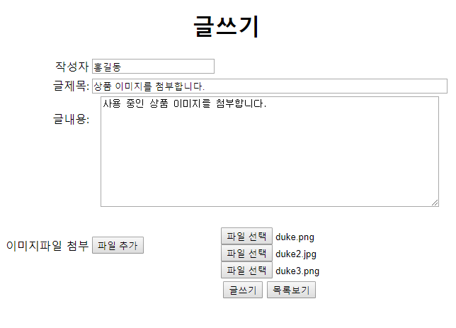
스프링 답변형 게시판
53. 브라우저에 요청하여 로그인한 후 다음과 같이 새 글을 작성 그리고 여러 개의 이미지 파일을 첨부한 후
글쓰기를 클릭하면 새 글이 등록된다.

Slide 85
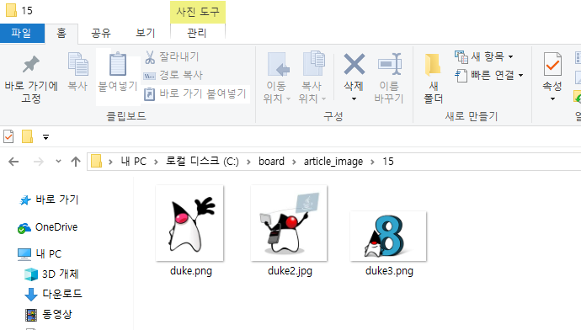
스프링 답변형 게시판
54. 글 번호에 해당하는 폴더를 열어 보면 첨부한 여러 개의 이미지 파일들이 실제로 업로드된것을 확인할 수
있다.

Slide 86
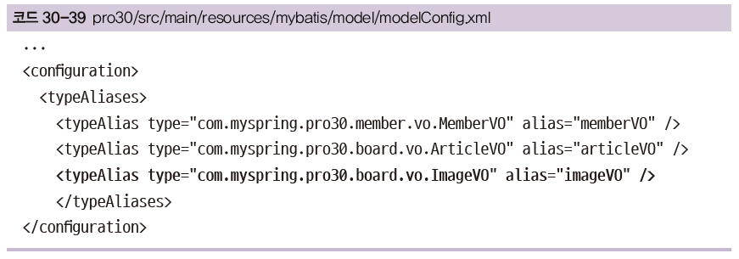
스프링 답변형 게시판
55. 글상세창에 여러 이미지 표시하기.
modelConfig.xml에 ImageVO에 대한 alias를 설정

Slide 87
스프링 답변형 게시판
56. board.xml이미지 파일 정보를 저장할 resultMap을 imageVO를 이용해 설정
<resultMap id="imgResult" type="imageVO">
<result property="imageFileNO" column="imageFileNO" />
<result property="articleNO" column="articleNO" />
<result property="imageFileName" column="imageFileName" />
</resultMap>
<select id="selectImageFileList" resultMap="imgResult" parameterType="int">
<![CDATA[
SELECT * from t_imageFile
where articleNO=#{articleNO}
]]>
</select>

Slide 88
스프링 답변형 게시판
57. JSP로 글 정보와 이미지 파일 정보를 한꺼번에 넘기도록 BoardControllerImpl.java 파일을 수정
articleMap에 각 정보를 key/value로 저장하여 JSP로 전달한다.
/* //한개의 이미지 보여주기
@RequestMapping(value="/board/viewArticle.do" ,method = RequestMethod.GET)
public ModelAndView viewArticle(@RequestParam("articleNO") int articleNO,
HttpServletRequest request, HttpServletResponse response) throws Exception{
String viewName = (String)request.getAttribute("viewName");
articleVO=boardService.viewArticle(articleNO);
ModelAndView mav = new ModelAndView();
mav.setViewName(viewName);
mav.addObject("article", articleVO);
return mav;
}
*/
//다중 이미지 보여주기
@RequestMapping(value="/board/viewArticle.do" ,method = RequestMethod.GET)
public ModelAndView viewArticle(@RequestParam("articleNO") int articleNO,
HttpServletRequest request, HttpServletResponse response) throws Exception{
String viewName = (String)request.getAttribute("viewName");
Map articleMap=boardService.viewArticle(articleNO);
ModelAndView mav = new ModelAndView();
mav.setViewName(viewName);
mav.addObject("articleMap", articleMap);
return mav;
}

Slide 89
스프링 답변형 게시판
58. 새 글과 이미지 파일 정보를 조회하도록 BoardServiceImpl.java서비스 파일을 수정
/* //단일 파일 보이기
@Override
public ArticleVO viewArticle(int articleNO) throws Exception {
ArticleVO articleVO = boardDAO.selectArticle(articleNO);
return articleVO;
}
*/
//다중 파일 보이기
@Override
public Map viewArticle(int articleNO) throws Exception {
Map articleMap = new HashMap();
ArticleVO articleVO = boardDAO.selectArticle(articleNO);
List<ImageVO> imageFileList = boardDAO.selectImageFileList(articleNO);
articleMap.put("article", articleVO);
articleMap.put("imageFileList", imageFileList);
return articleMap;
}
-BoardDAOImpl 클래스
@Override
public ArticleVO selectArticle(int articleNO) throws DataAccessException {
return sqlSession.selectOne("mapper.board.selectArticle", articleNO);
}
@Override
public List selectImageFileList(int articleNO) throws DataAccessException {
List<ImageVO> imageFileList = null;
imageFileList = sqlSession.selectList("mapper.board.selectImageFileList",articleNO);
return imageFileList;
}

Slide 90
스프링 답변형 게시판
59. viewArticle.jsp 파일에서는 이미지 파일 정보가 imageFileList로 전달되도록 설정
<c:forEach>태그를 이용해 imageFileList에 저장된 ImageVO의 개수만큼 이미지를 표시한다
<c:set var="article" value="${articleMap.article}" />
<c:set var="imageFileList" value="${articleMap.imageFileList}" />
: :
<td width="150" align="center" bgcolor="#FF9933">
내용
</td>
<td>
<textarea rows="20" cols="60" name="content" id="i_content" disabled />${article.content }</textarea>
</td>
</tr>
<c:if test="${not empty imageFileList && imageFileList!='null' }">
<c:forEach var="item" items="${imageFileList}" varStatus="status" >
<tr>
<td width="150" align="center" bgcolor="#FF9933" rowspan="2">
이미지${status.count }
</td>
<td>
<input type= "hidden" name="originalFileName" value="${item.imageFileName }" />
<img src="${contextPath}/download.do?articleNO=${article.articleNO}&imageFileName=${item.imageFileName}" id="preview" /><br>
</td>
</tr>
<tr>
<td>
<input type="file" name="imageFileName " id="i_imageFileName" disabled onchange="readURL(this);" />
</td>
</tr>
</c:forEach>
</c:if>
<c:choose>
<c:when test="${not empty article.imageFileName && article.imageFileName!='null' }">
<tr>

Slide 91
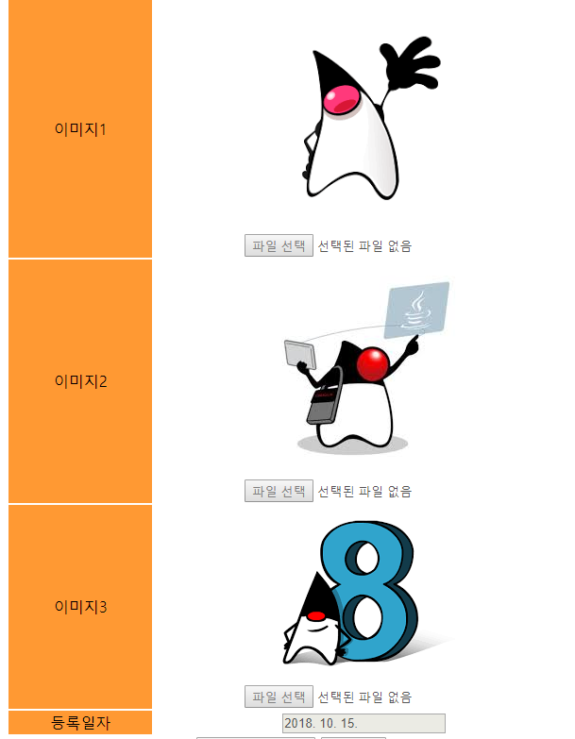
스프링 답변형 게시판
60. 실행 결과를 보면 첨부한 세 개의 이미지가 나타난다.

